Slide 1
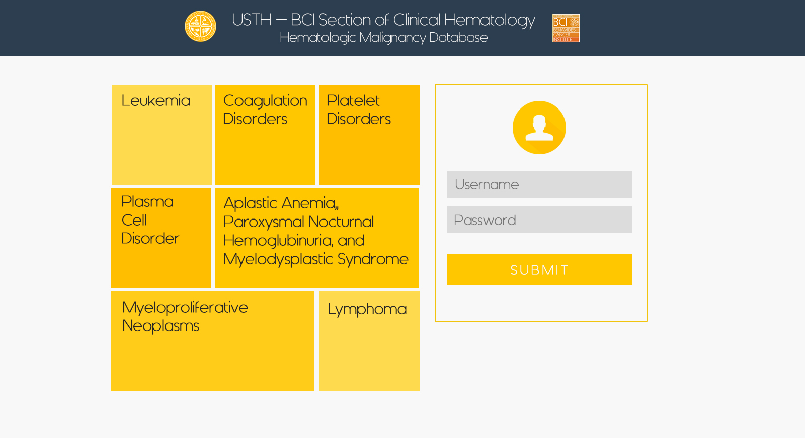
Home page

Slide 2
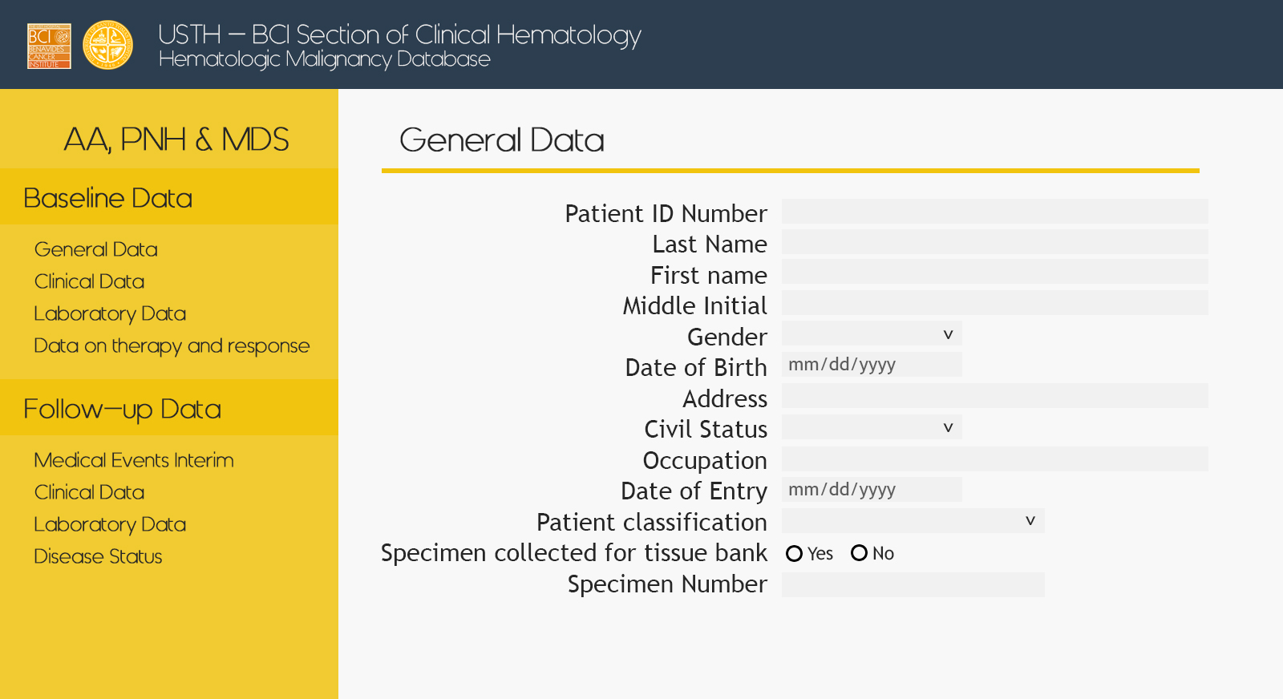
AAPNHMD – Baseline – General

Slide 3
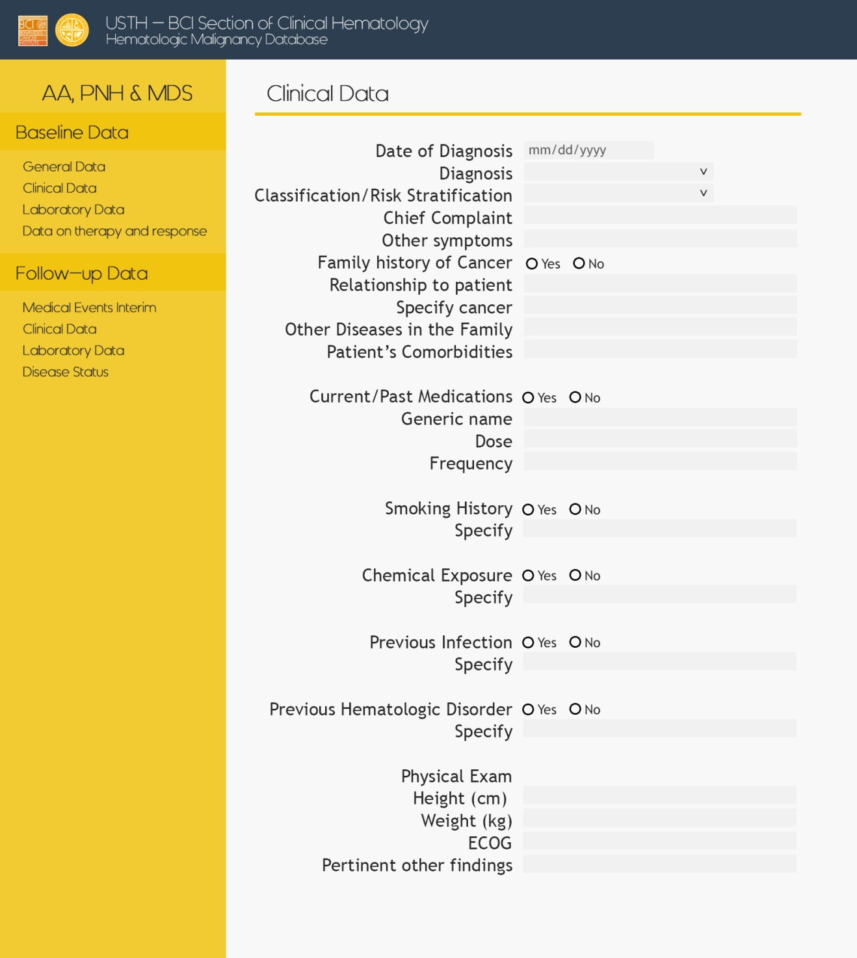
AAPNHMD – Baseline – Clinical

Slide 4
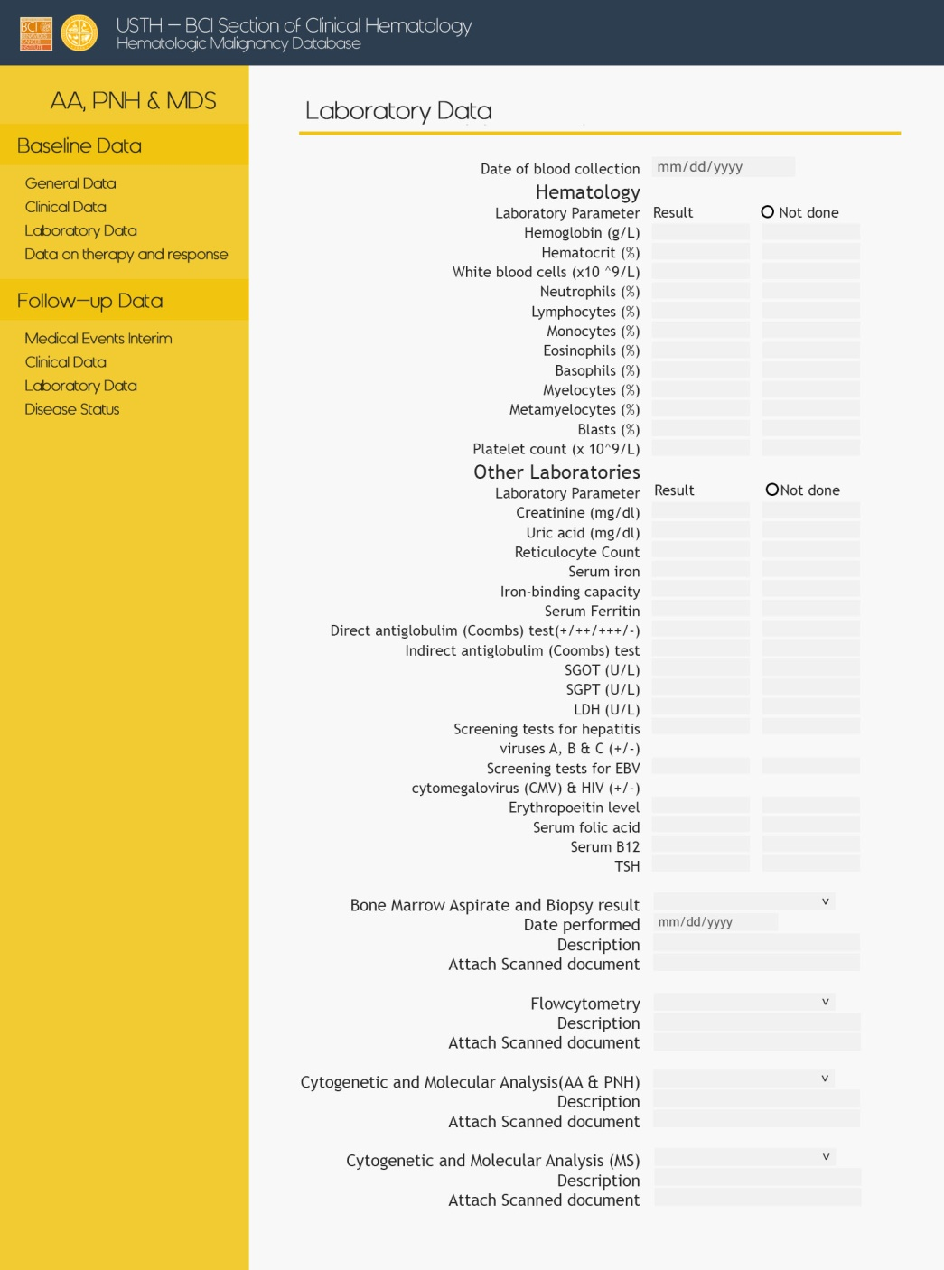
AAPNHMD – Baseline – Laboratory

Slide 5
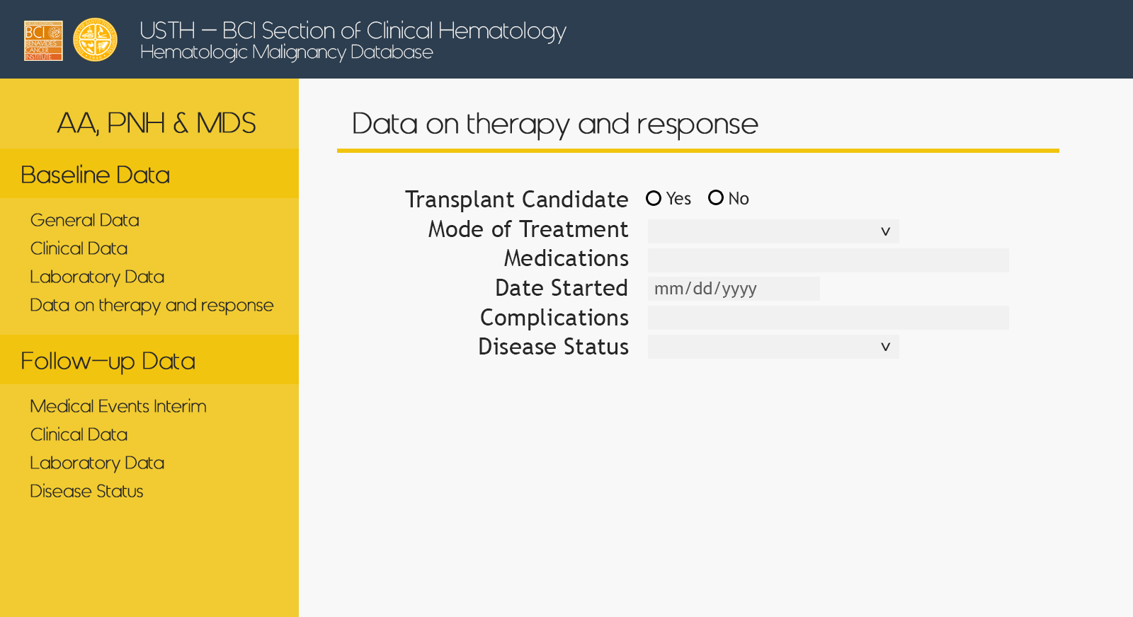
AAPNHMD – Baseline – Therapy

Slide 6
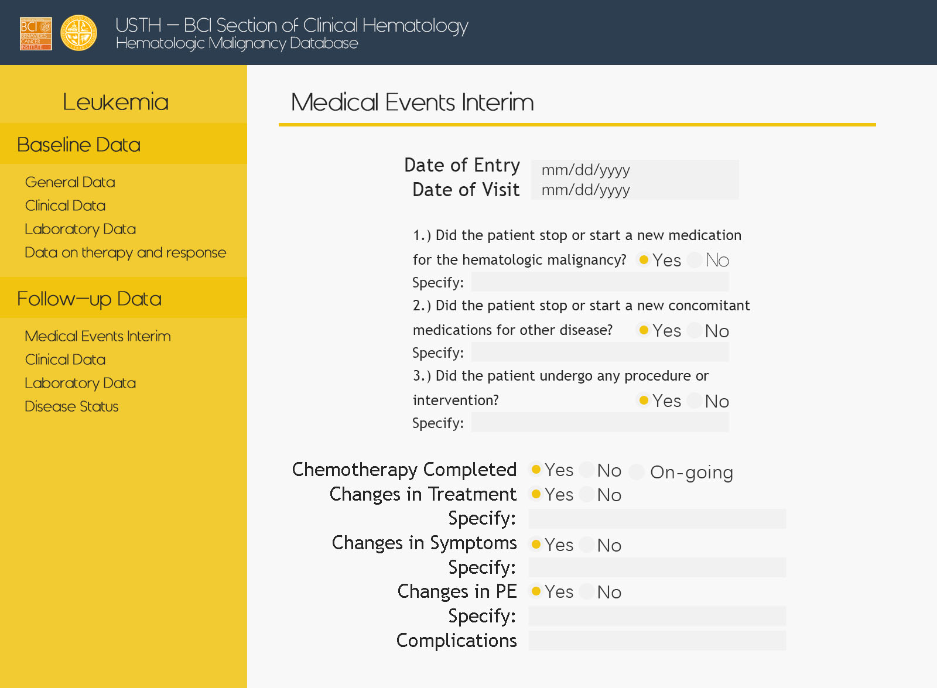
AAPNHMD – Follow up – Med Events

Slide 7
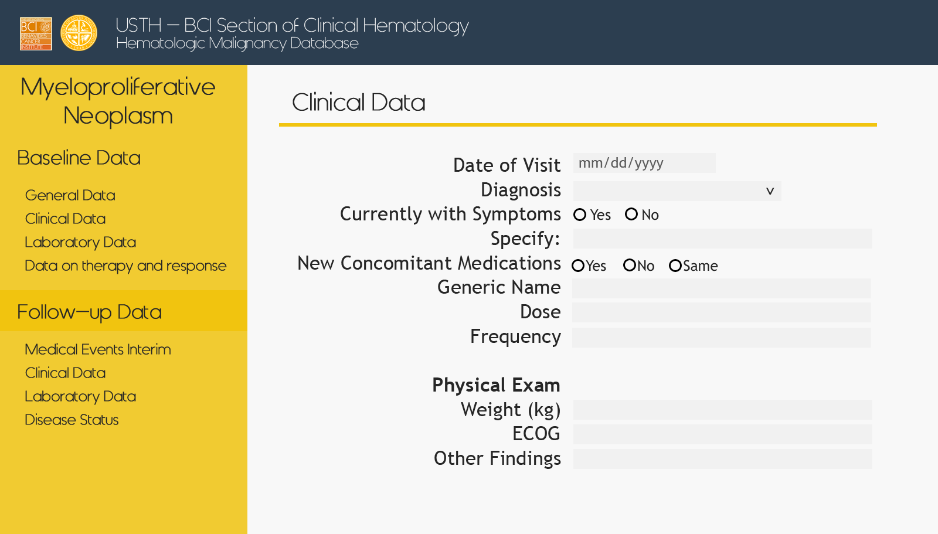
AAPNHMD – Follow up – Clinical

Slide 8
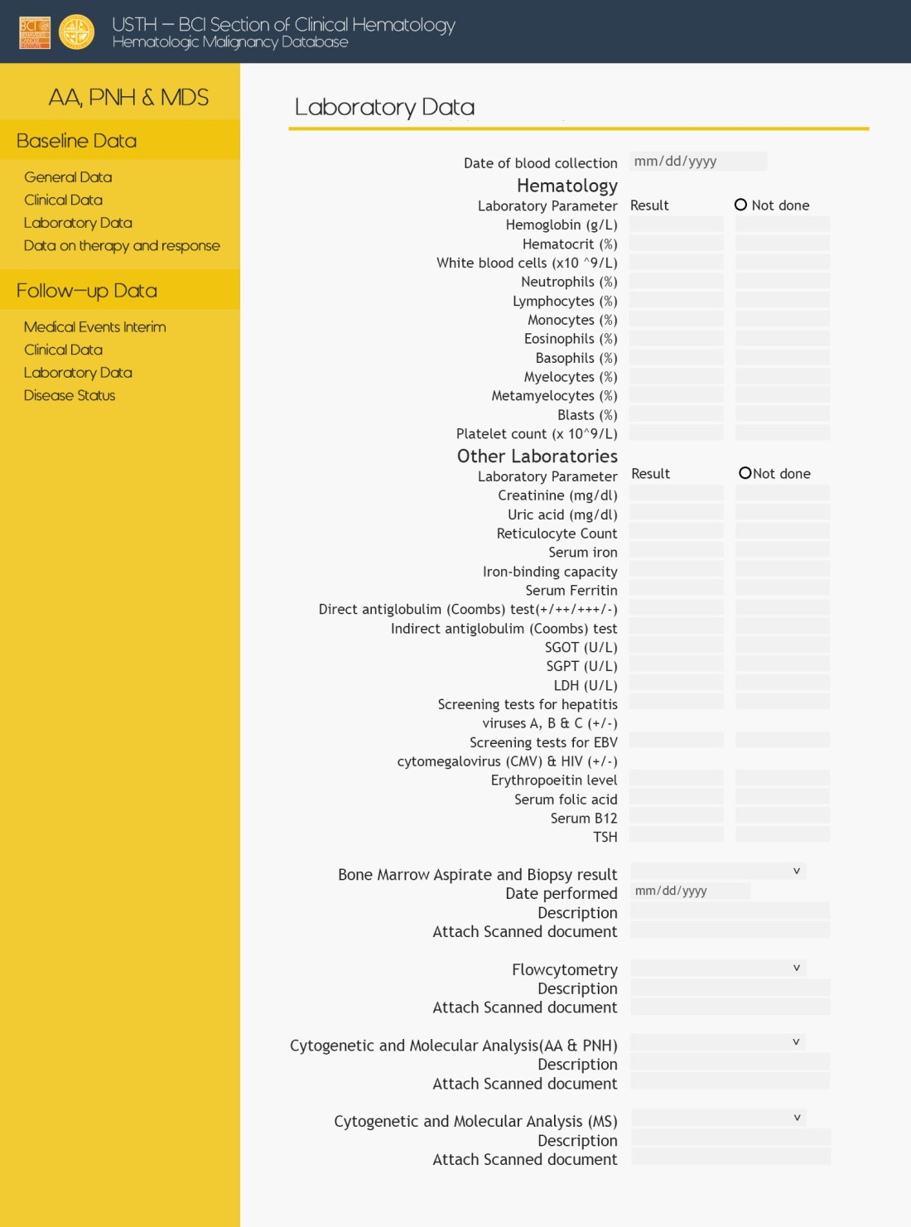
AAPNHMD – Follow up – Laboratory

Slide 9
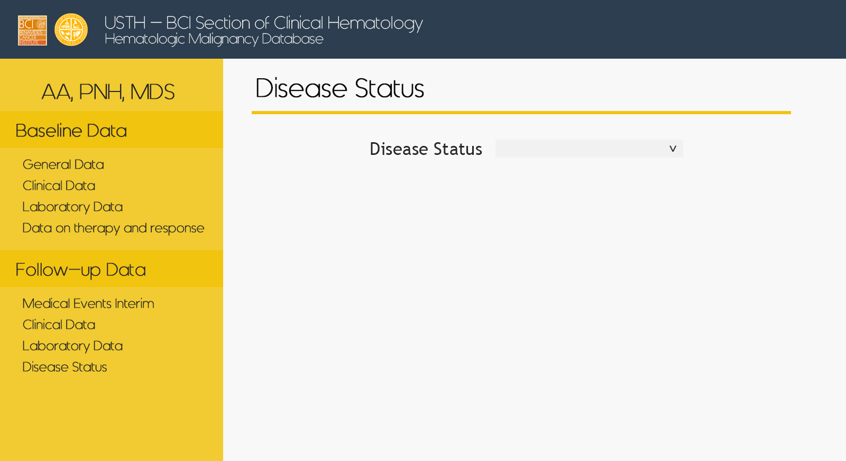
AAPNHMD – Follow up – Disease Status

Slide 10
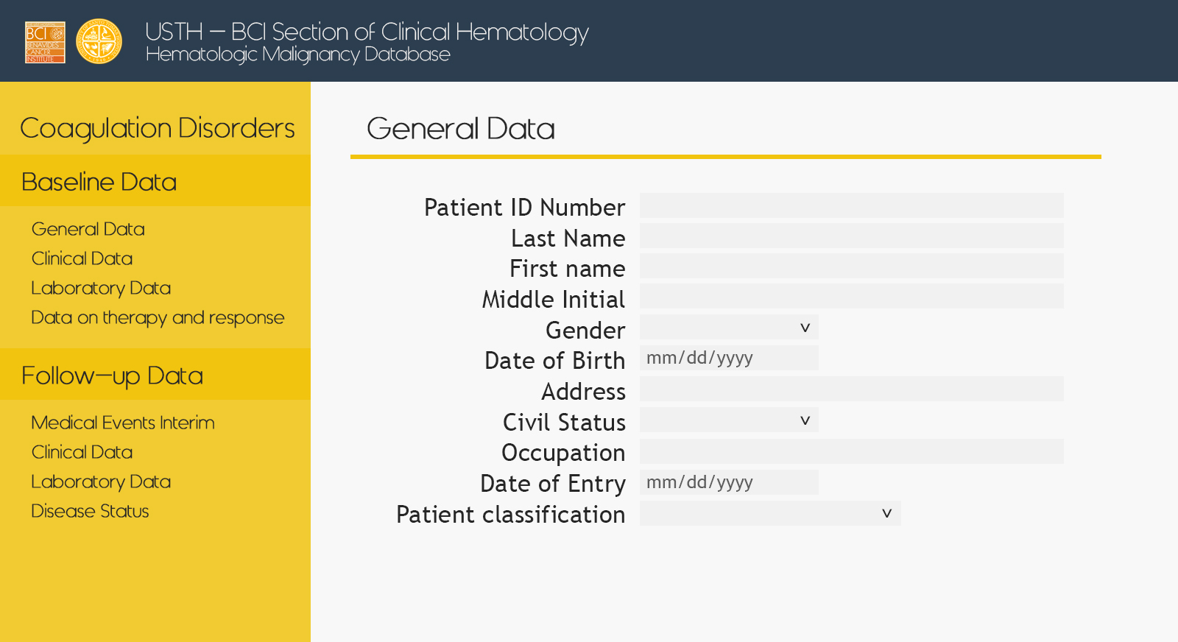
Coagulation – Baseline – General

Slide 11
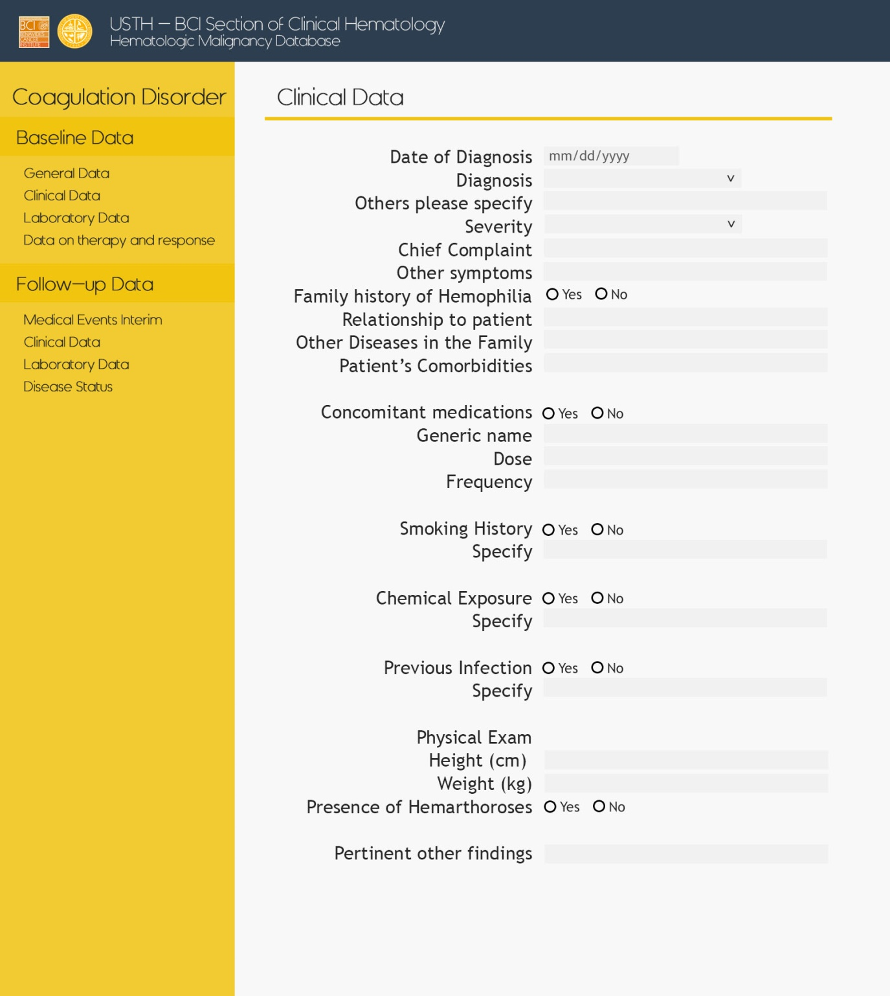
Coagulation – Baseline – Clinical

Slide 12
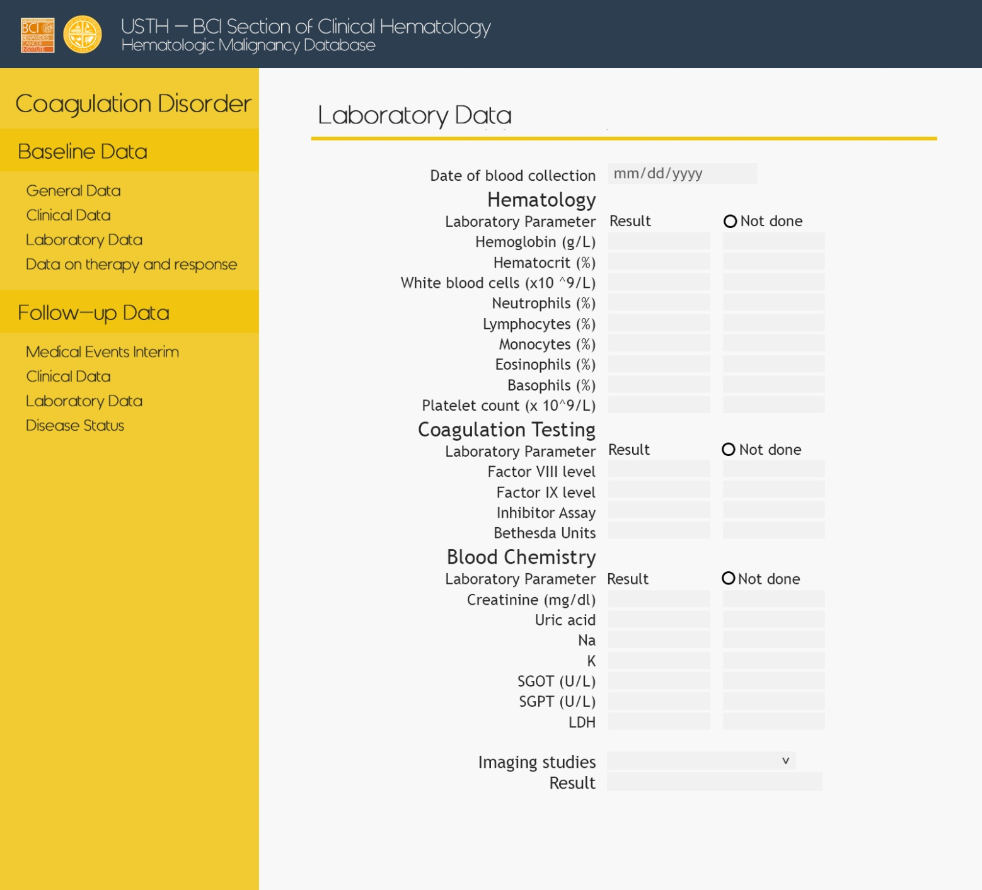
Coagulation – Baseline – Laboratory

Slide 13
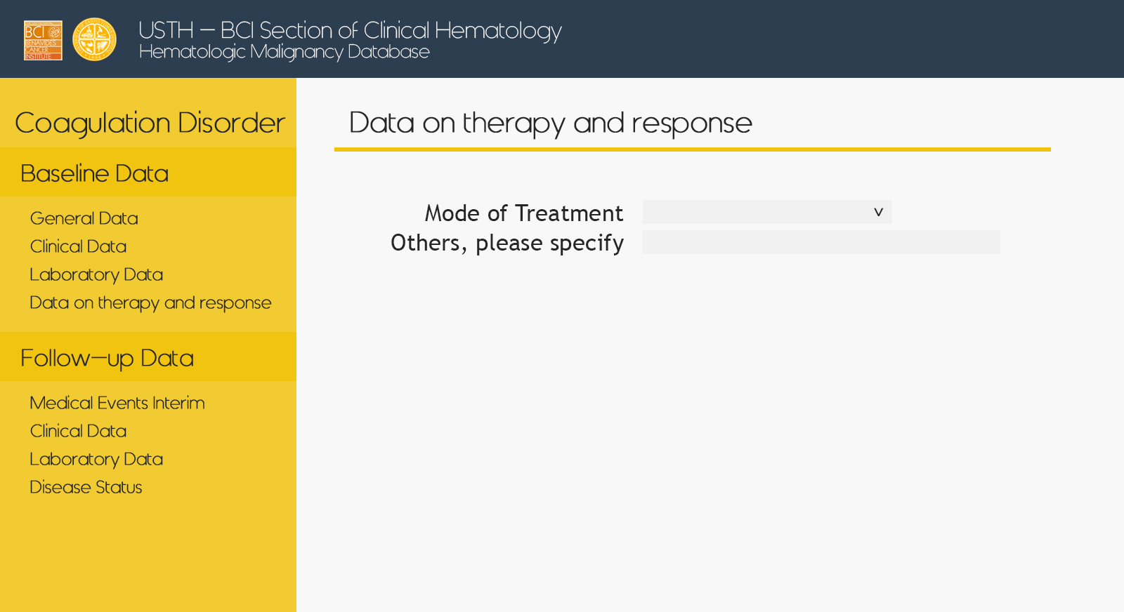
Coagulation – Baseline – Therapy

Slide 14
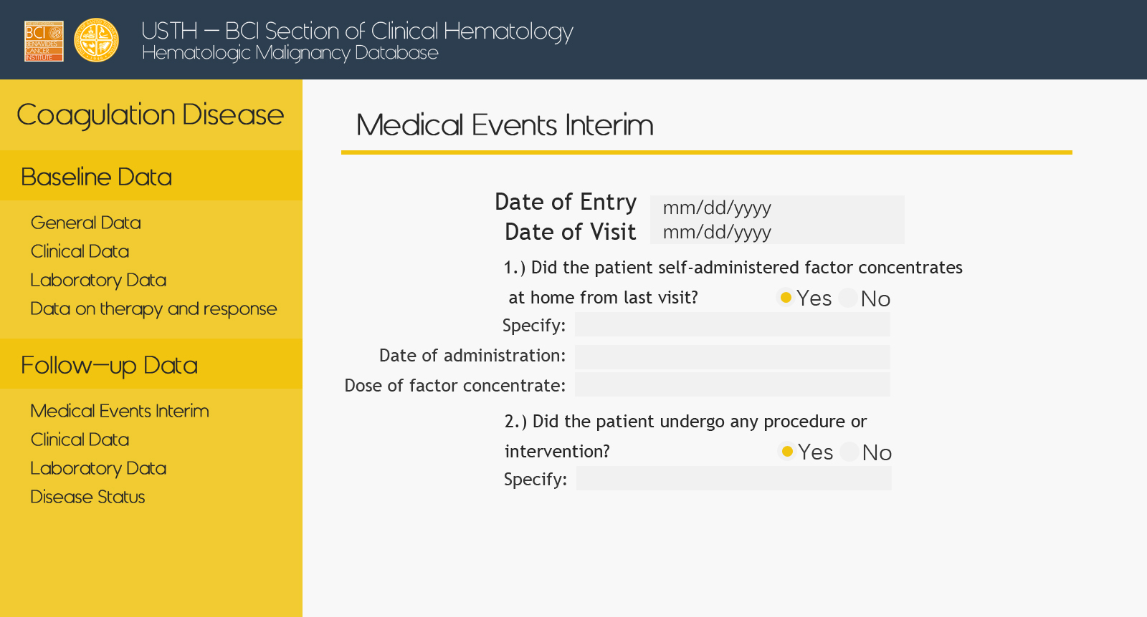
Coagulation – Follow up – Med Events

Slide 15
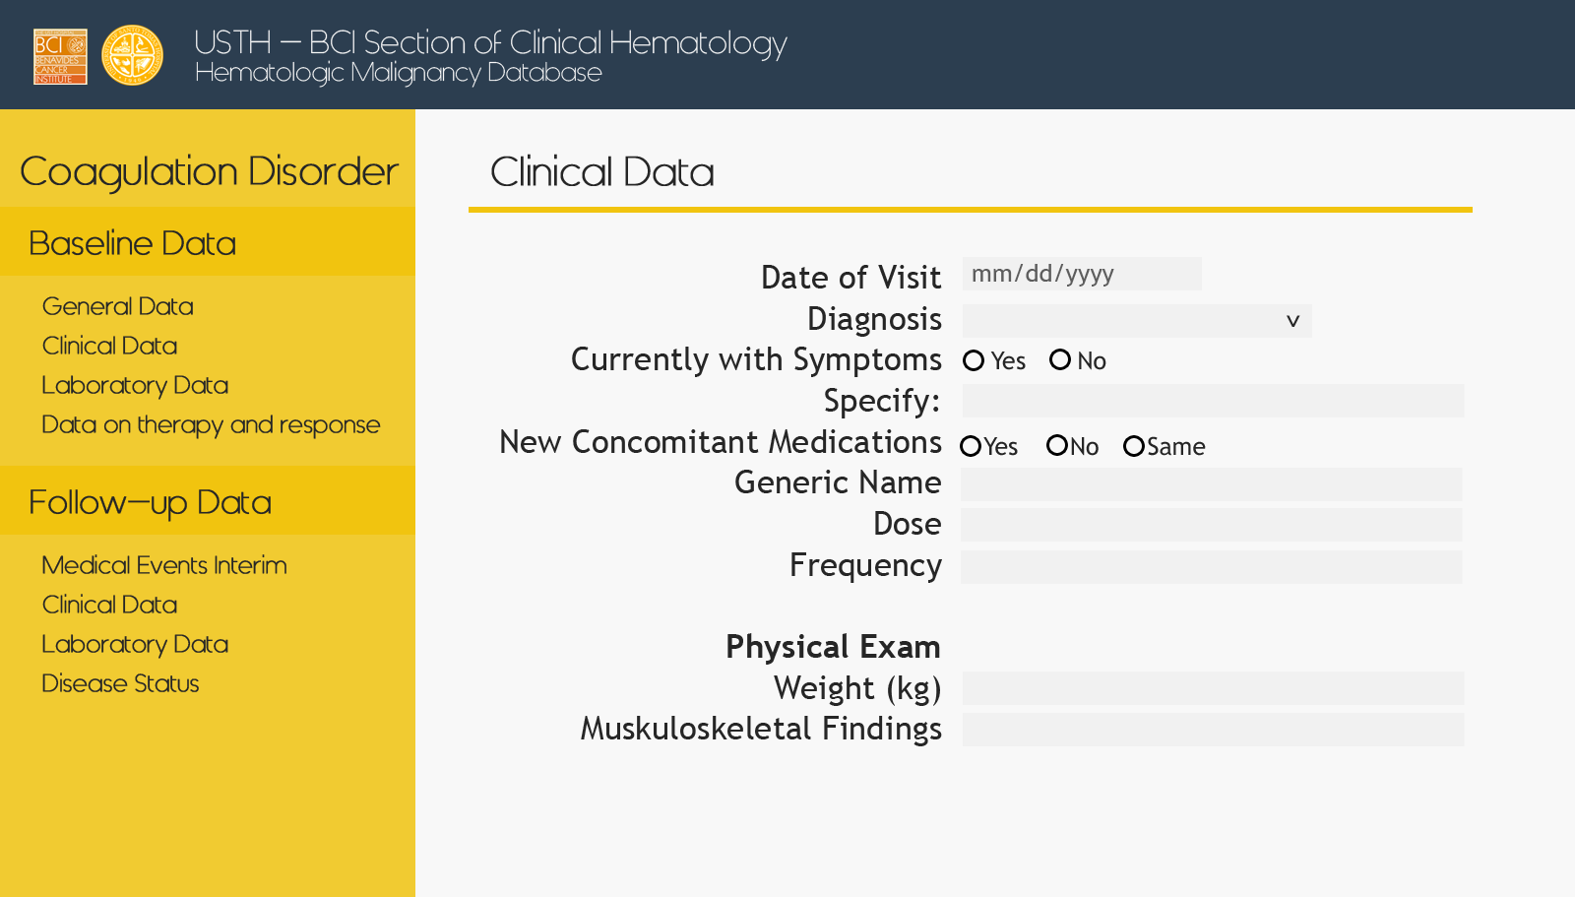
Coagulation – Follow up – Clinical

Slide 16
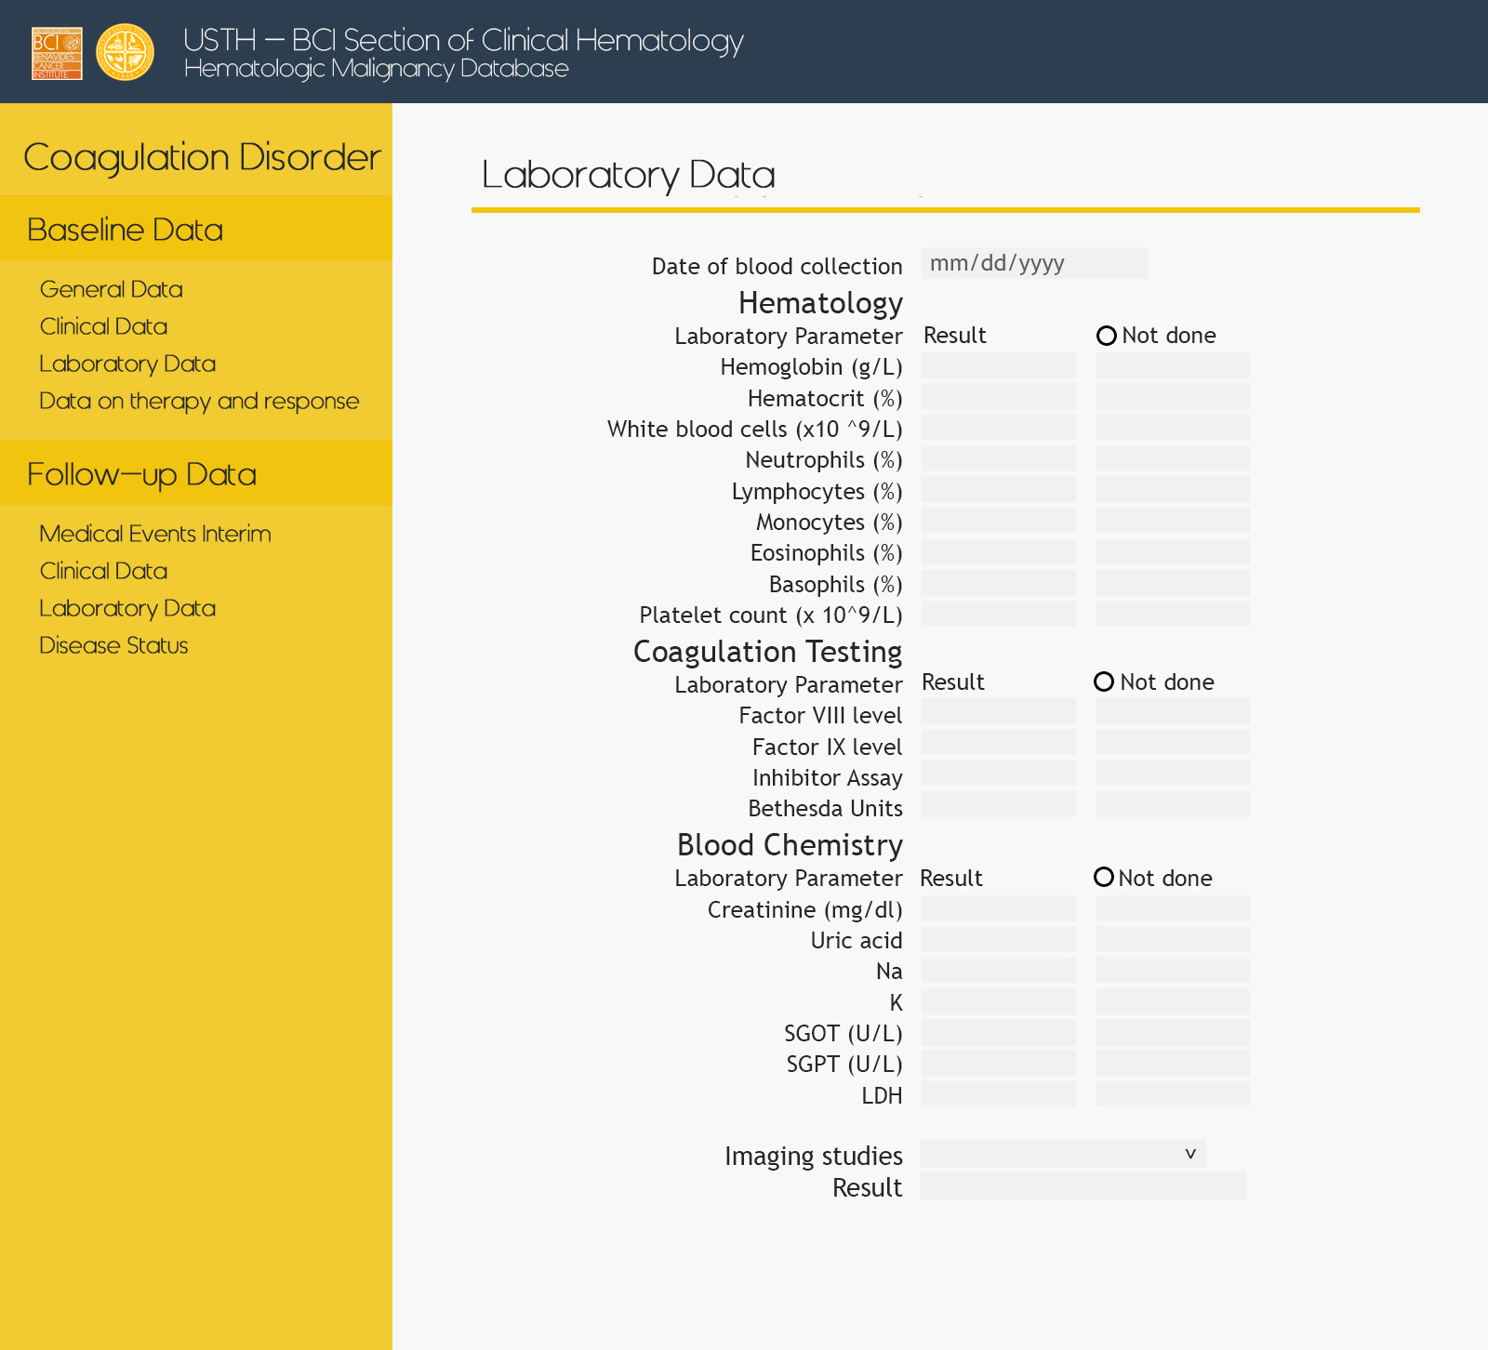
Coagulation – Follow up – Laboratory

Slide 17
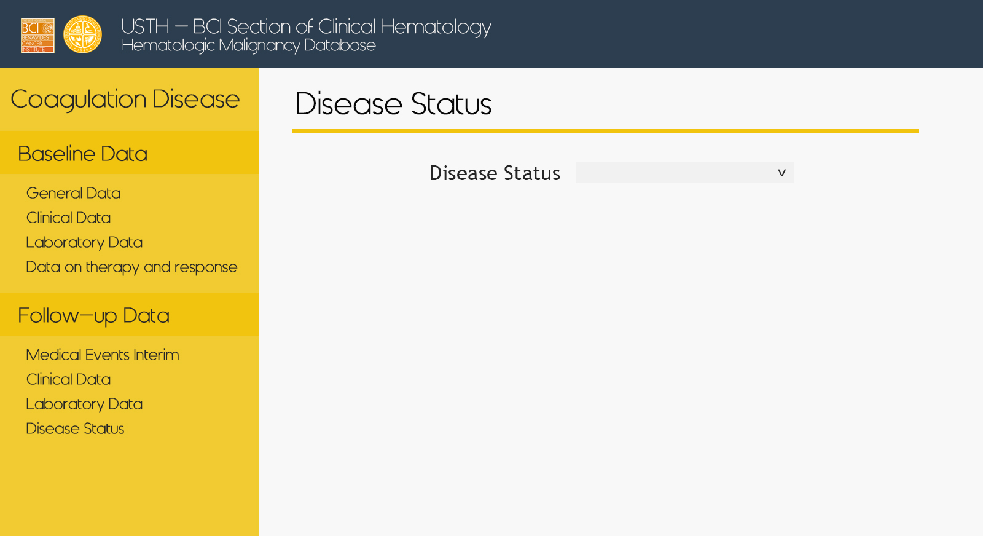
Coagulation – Follow up – Disease Status

Slide 18
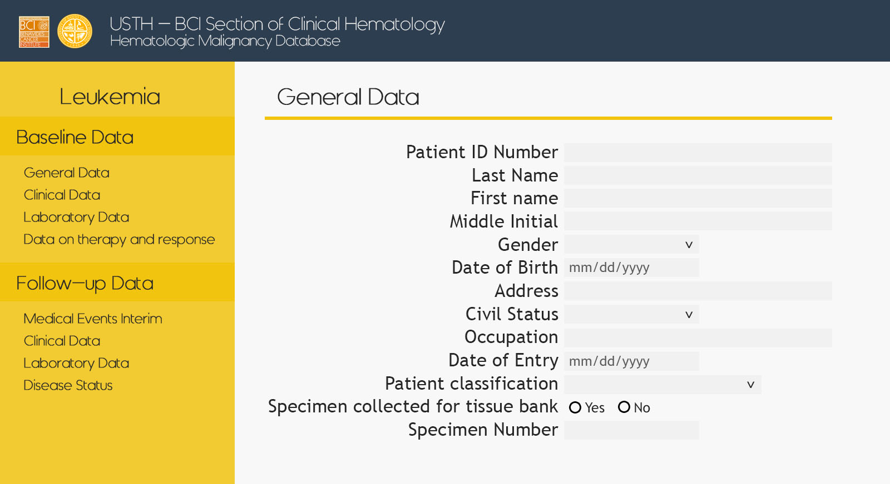
Leukemia – Baseline – General

Slide 19
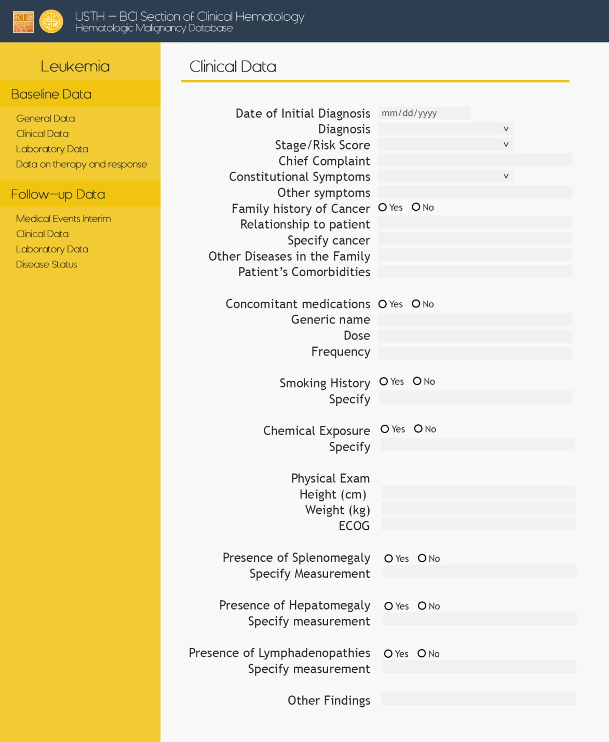
Leukemia – Baseline – Clinical

Slide 20
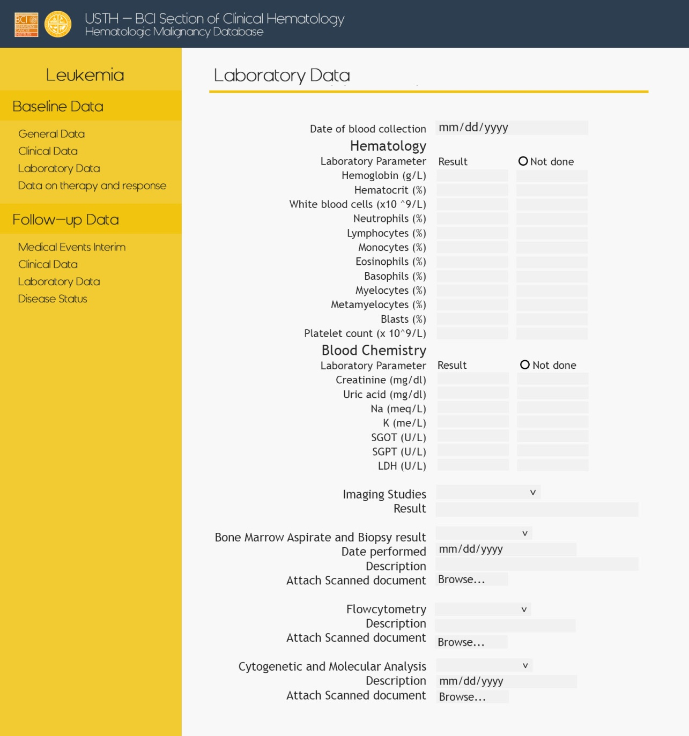
Leukemia – Baseline – Laboratory

Slide 21
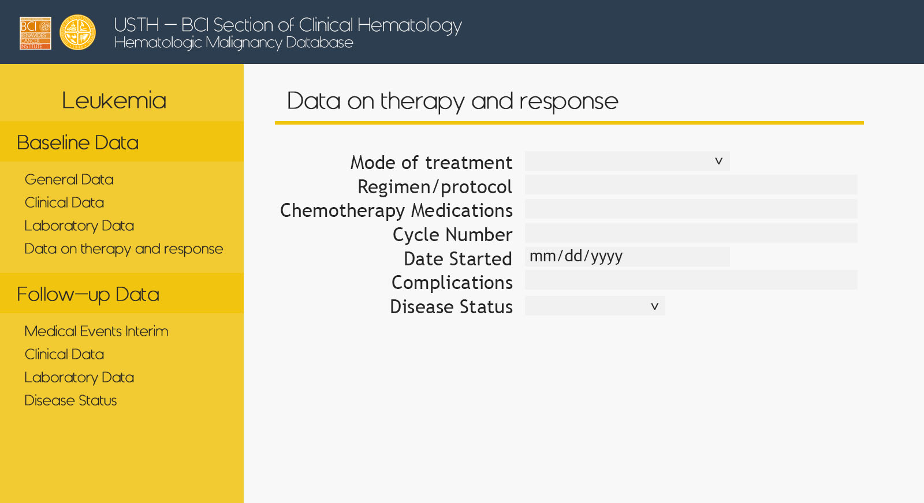
Leukemia – Baseline – Therapy

Slide 22
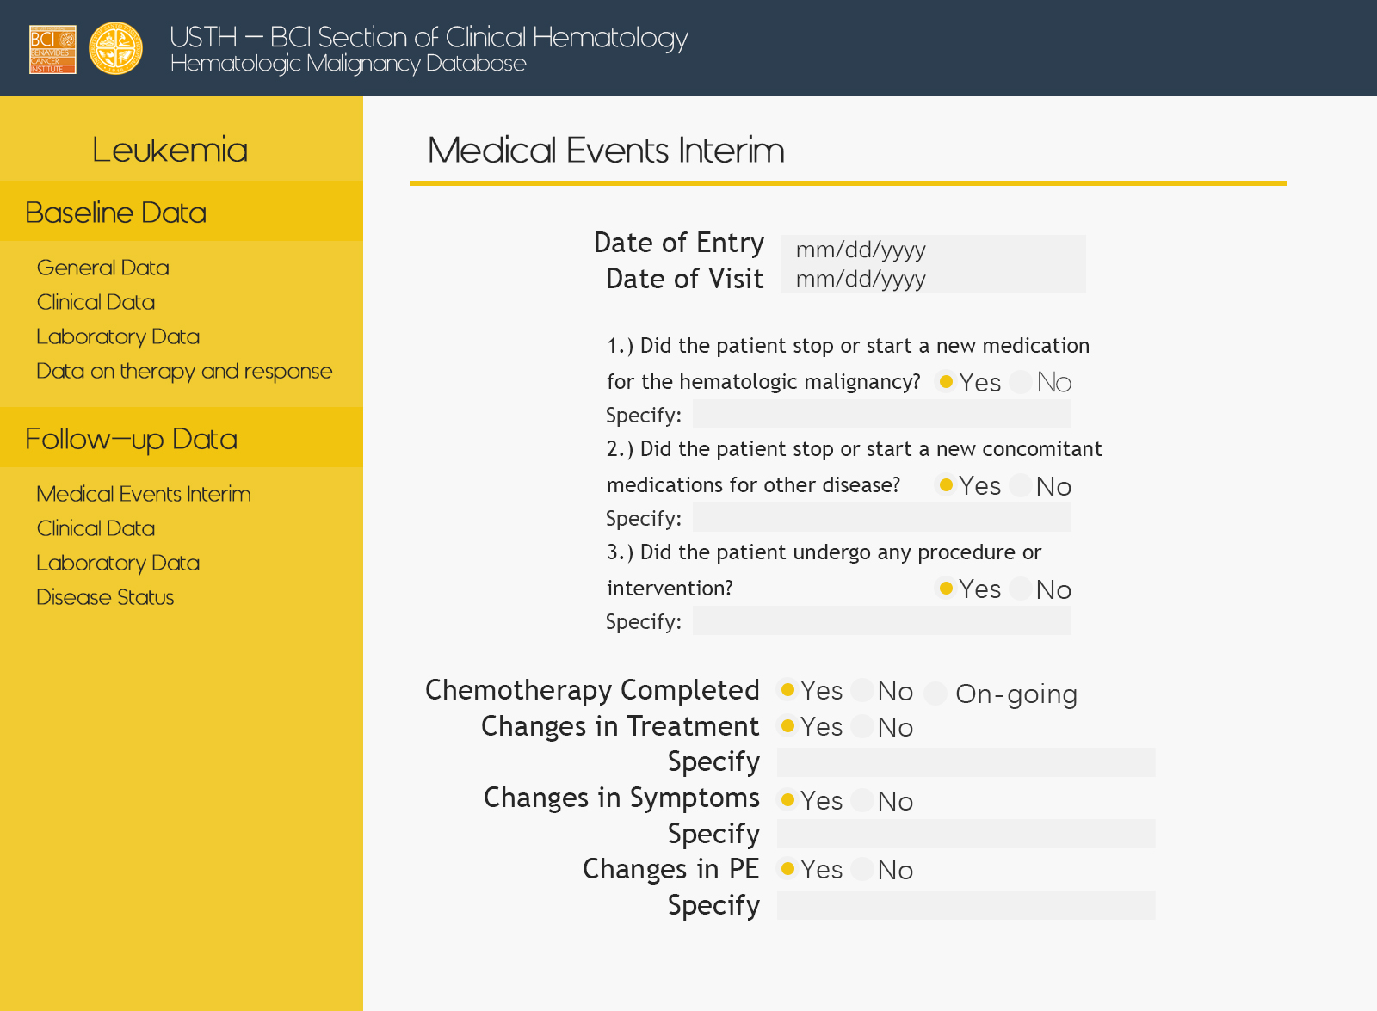
Leukemia – Follow up – Med Events

Slide 23
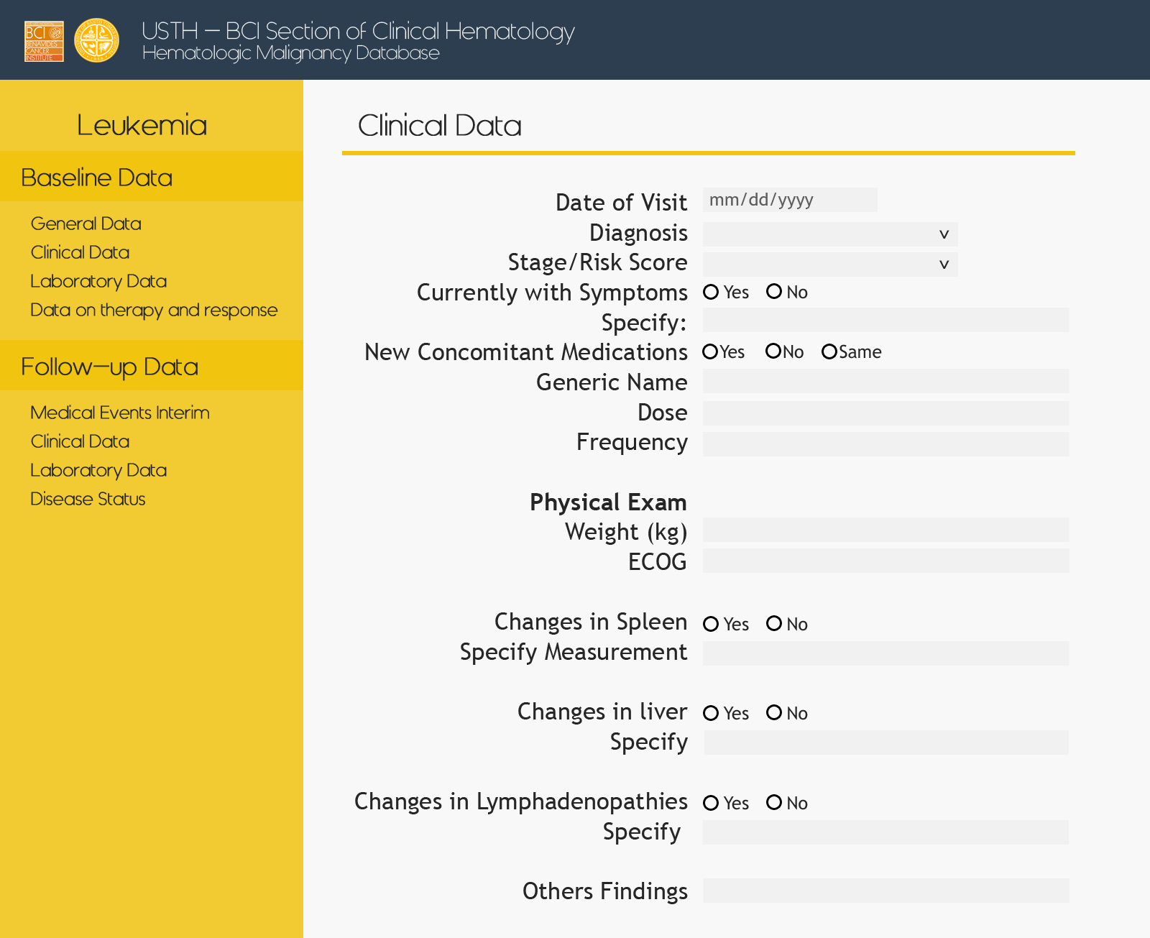
Leukemia – Follow up – Clinical

Slide 24
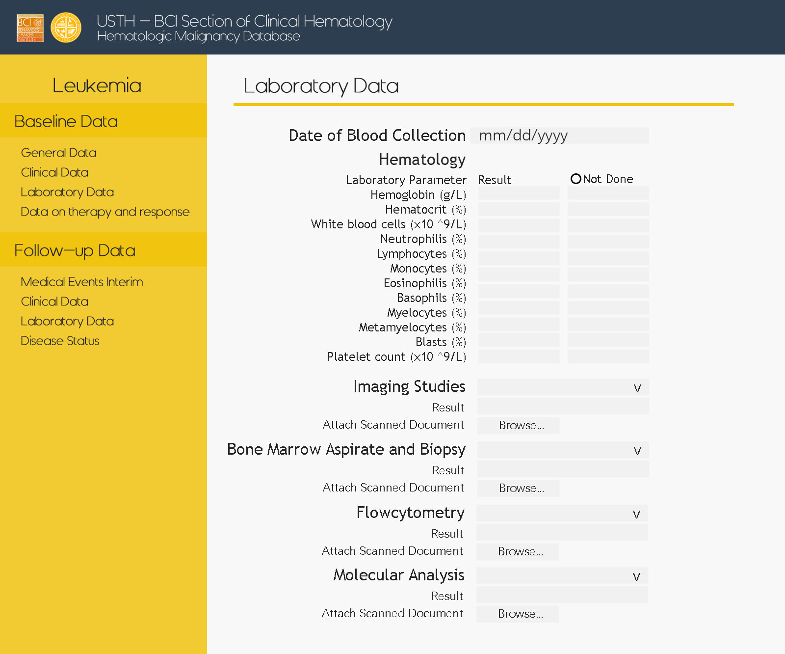
Leukemia – Follow up – Laboratory

Slide 25
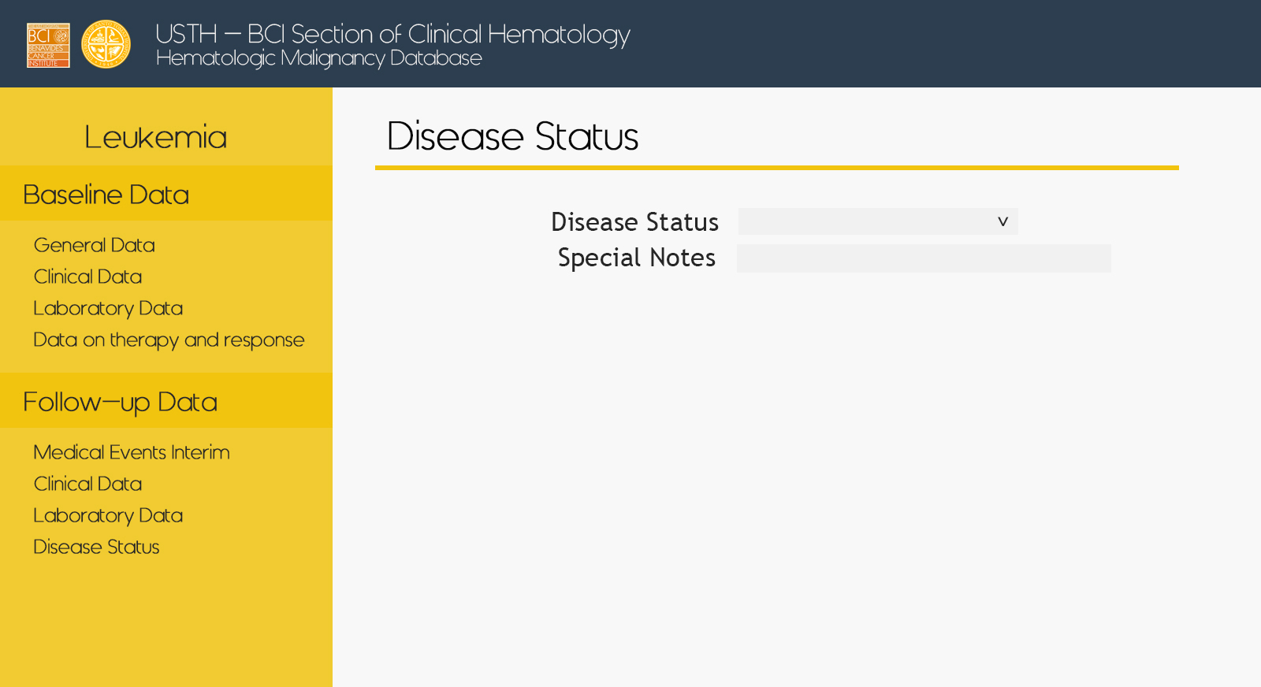
Leukemia – Follow up – Disease Status

Slide 26
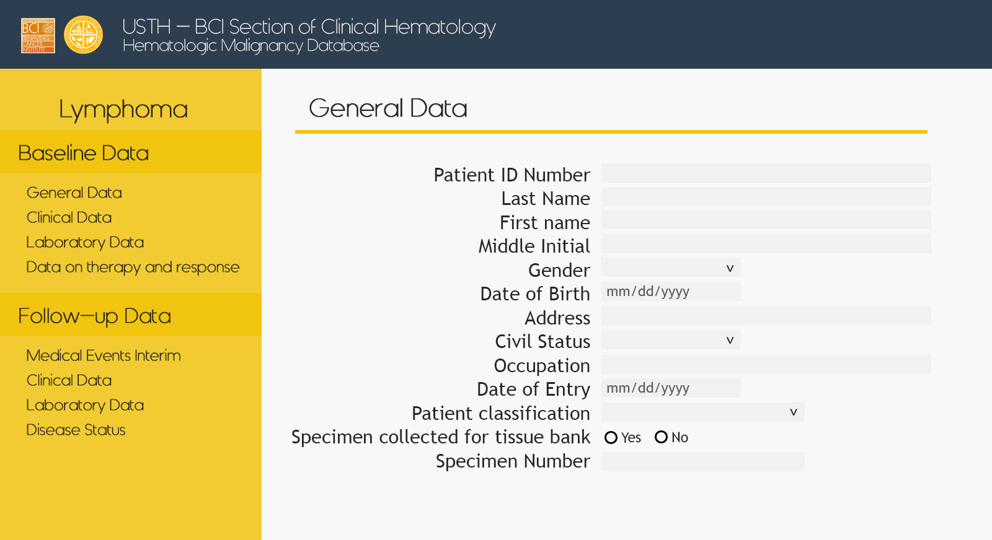
Lymphoma – Baseline – General

Slide 27
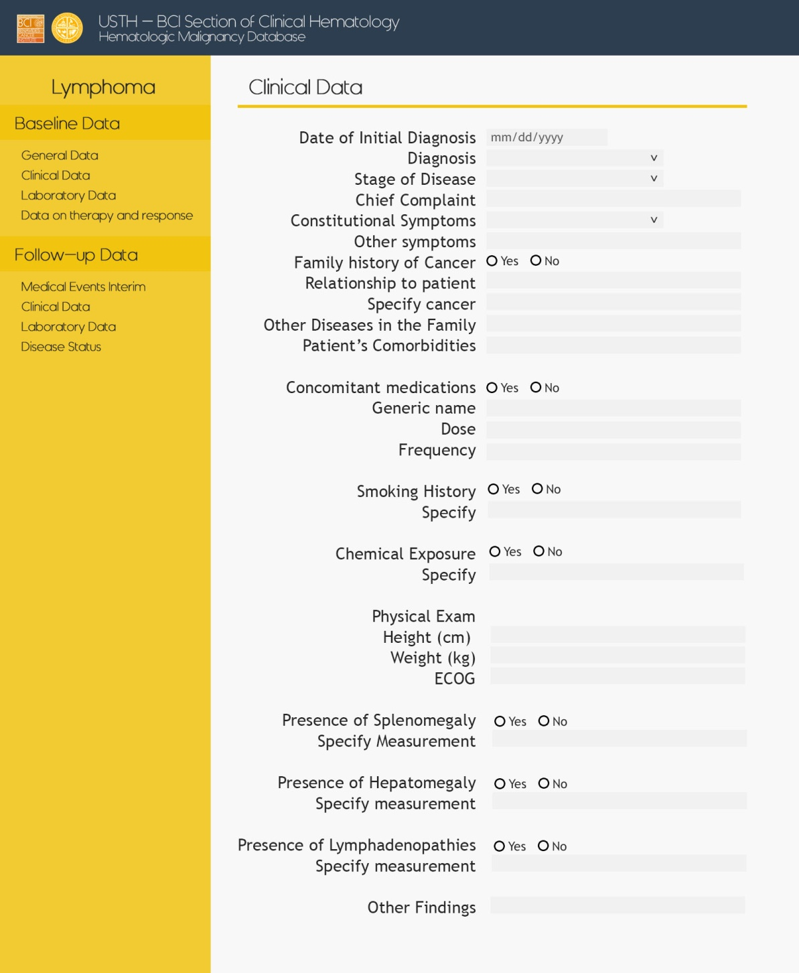
Lymphoma – Baseline – Clinical

Slide 28
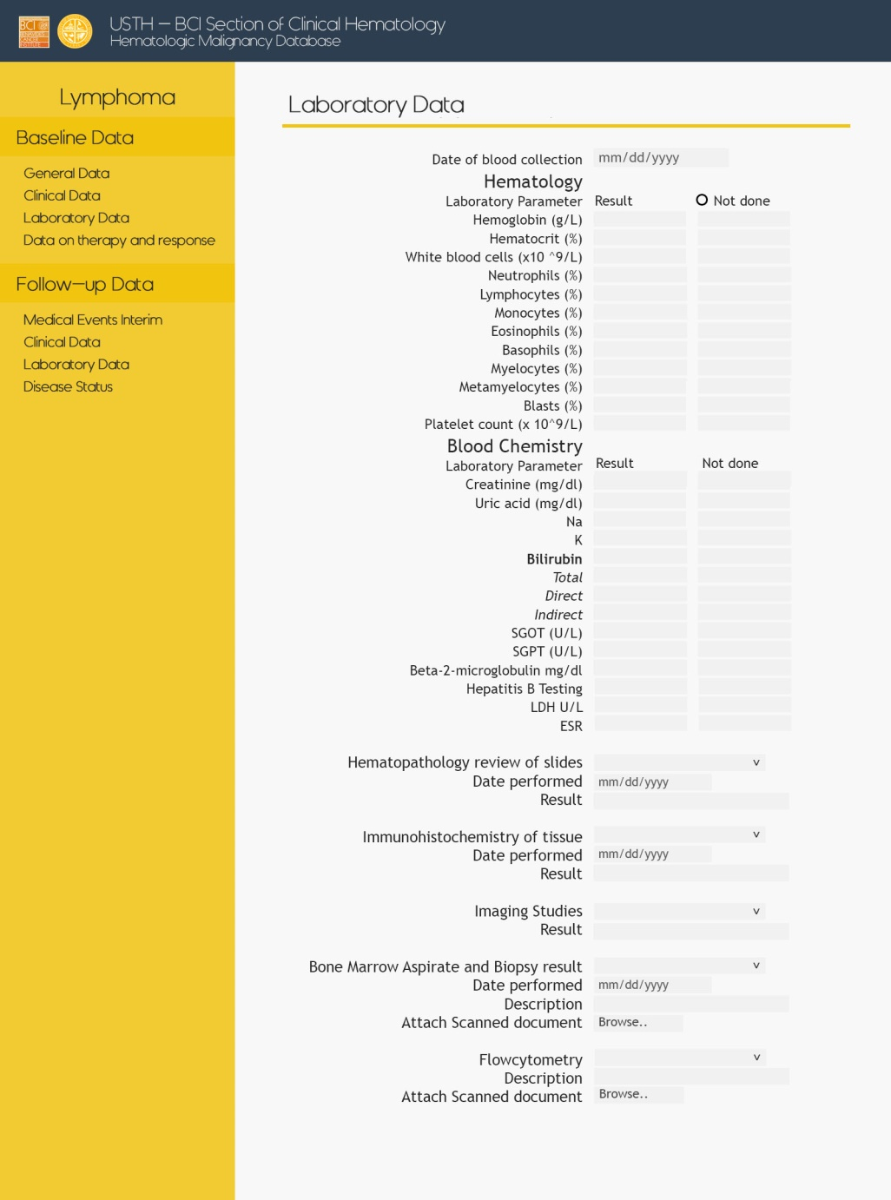
Lymphoma – Baseline – Laboratory

Slide 29
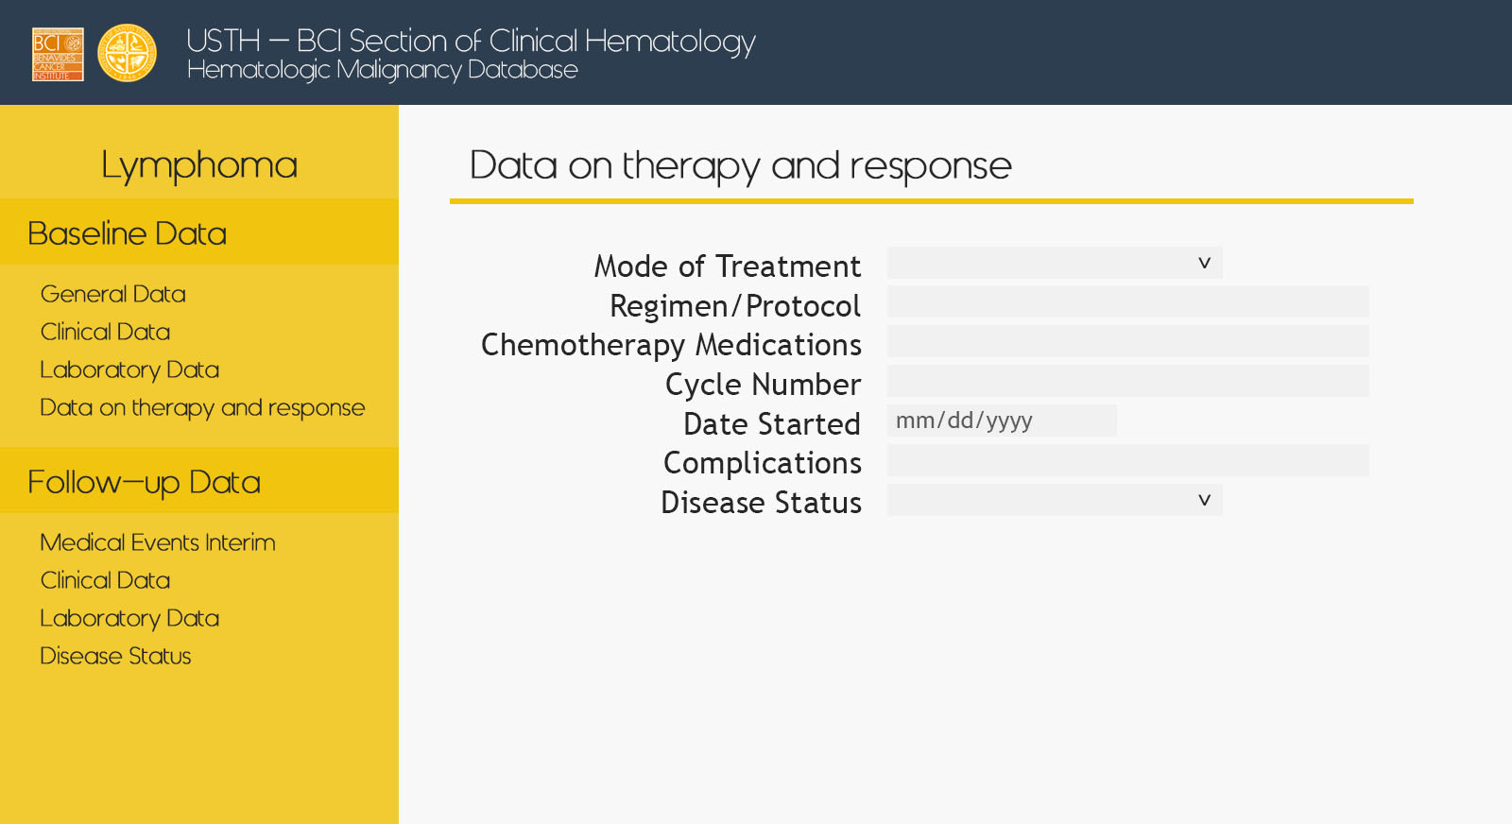
Lymphoma – Baseline – Therapy

Slide 30
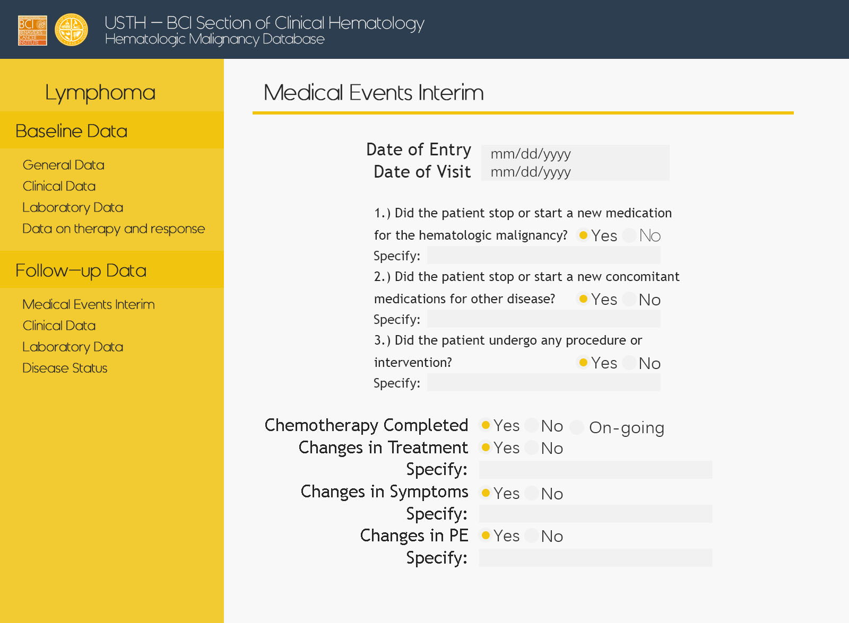
Lymphoma – Follow up – Med Events

Slide 31
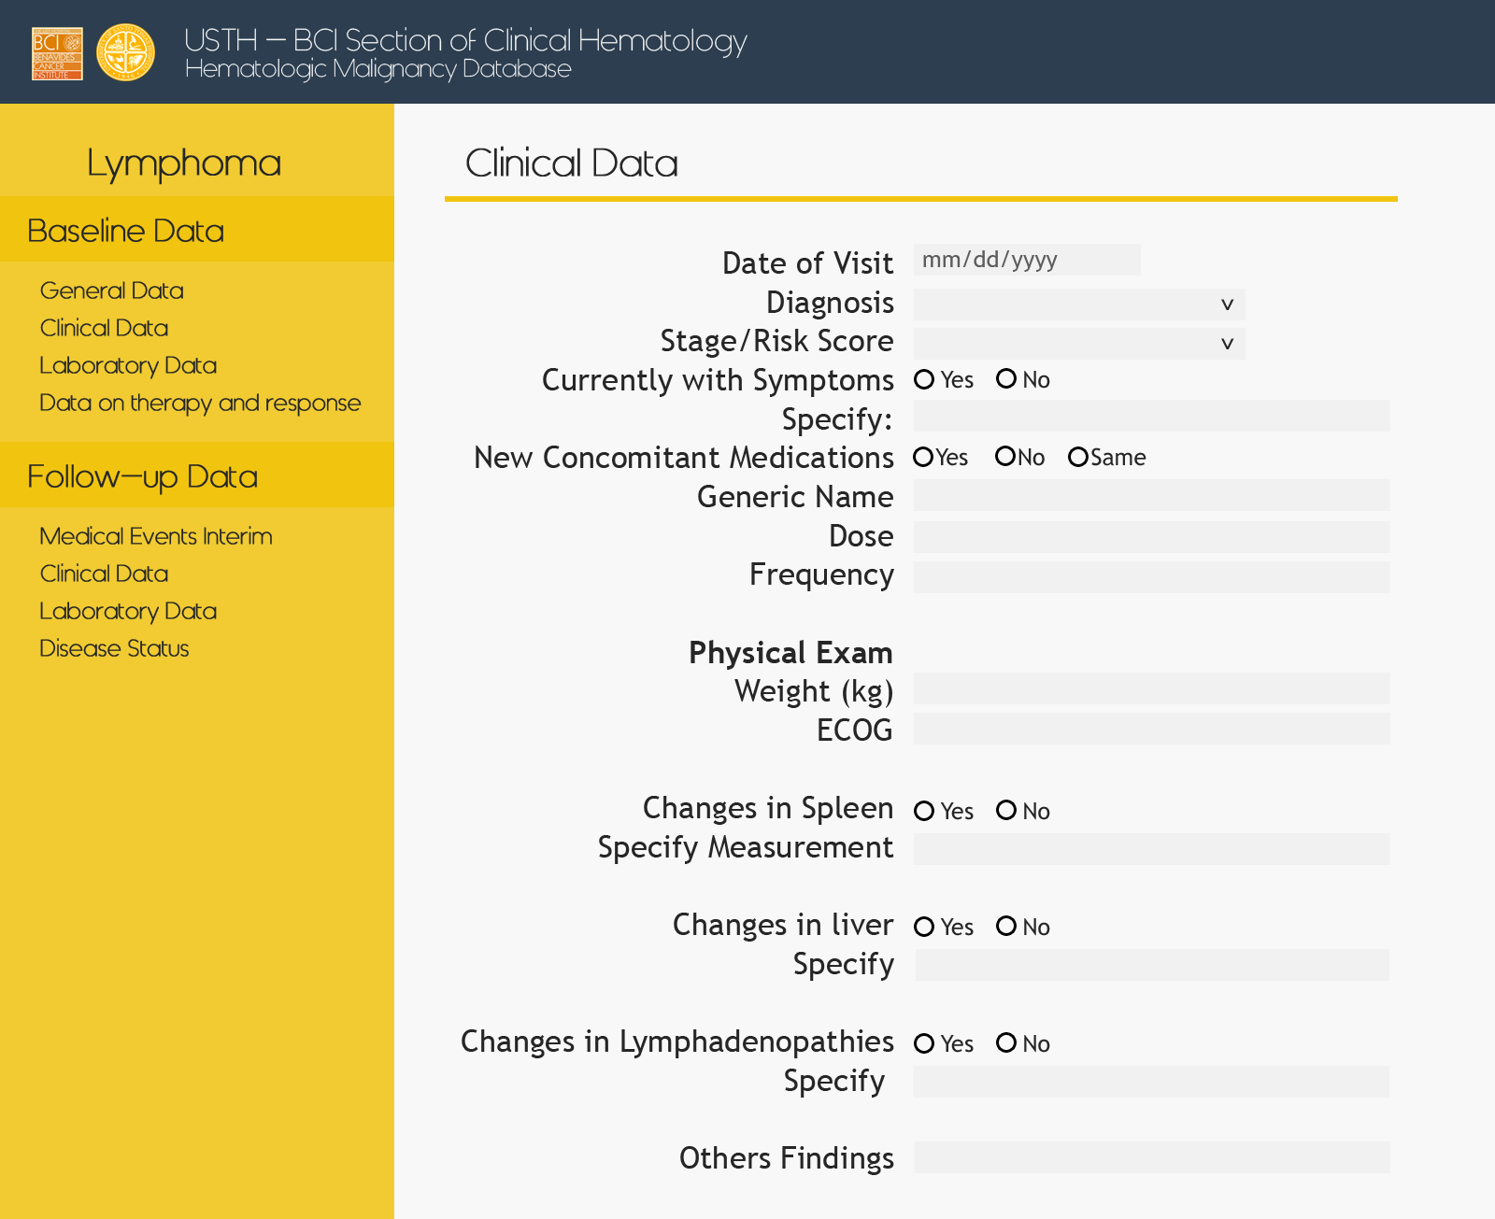
Lymphoma – Follow up – Clinical

Slide 32
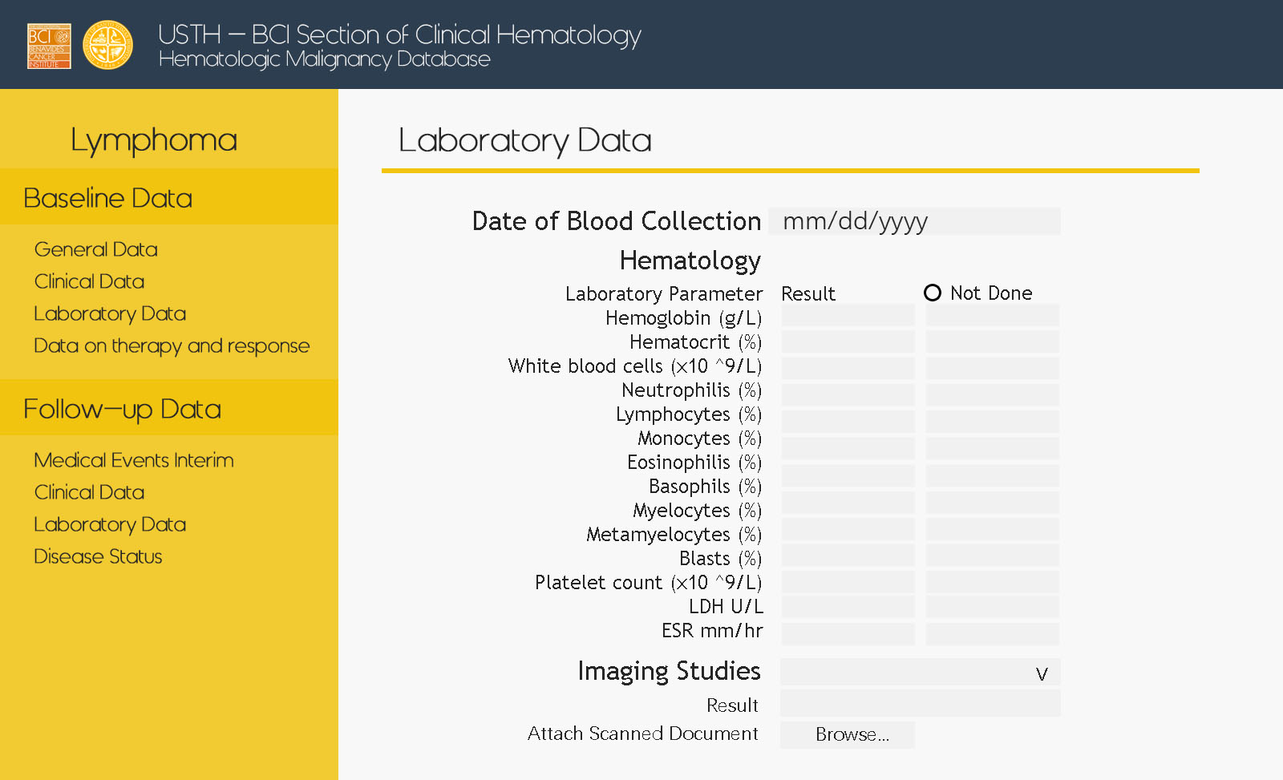
Lymphoma – Follow up – Laboratory

Slide 33
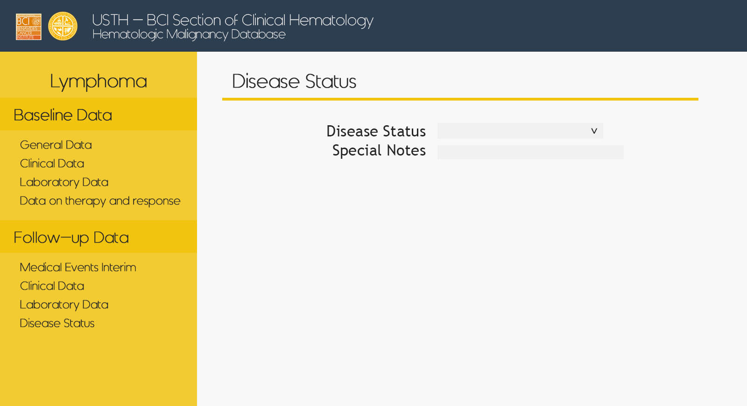
Lymphoma – Follow up – Disease Status

Slide 34
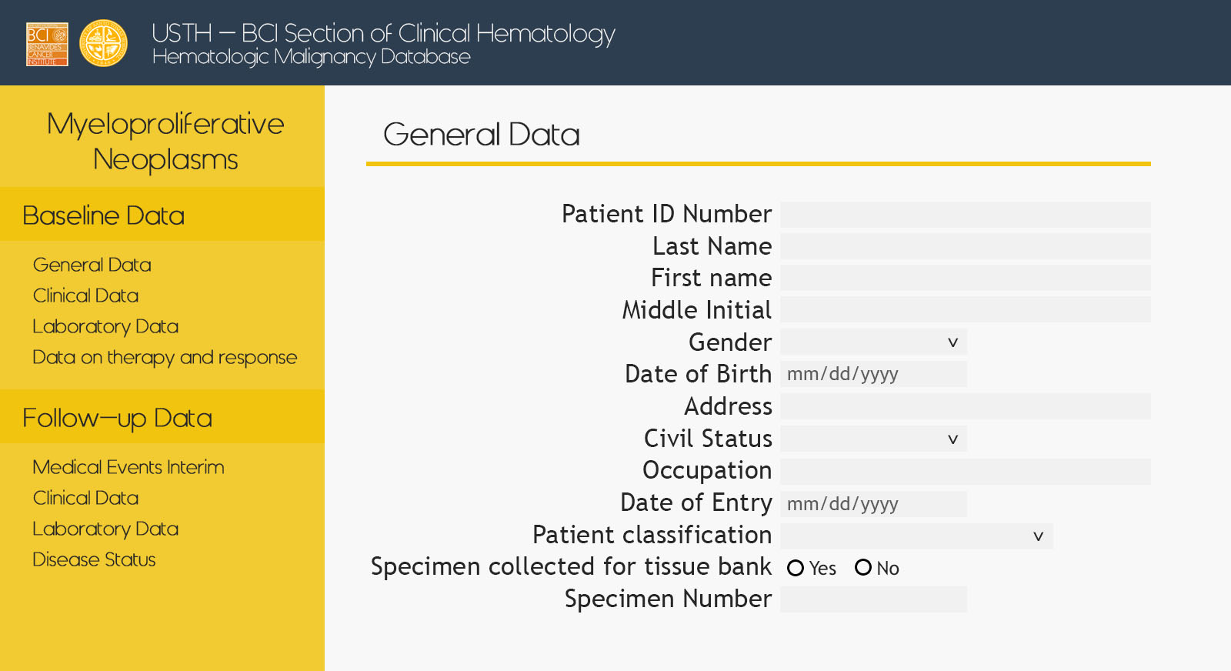
Myelo – Baseline – General

Slide 35
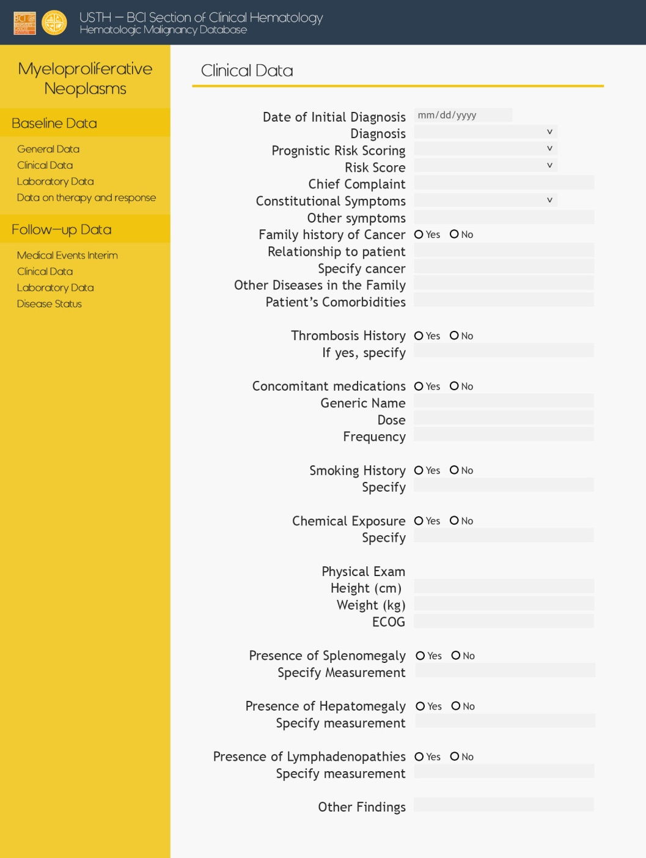
Myelo – Baseline – Clinical

Slide 36
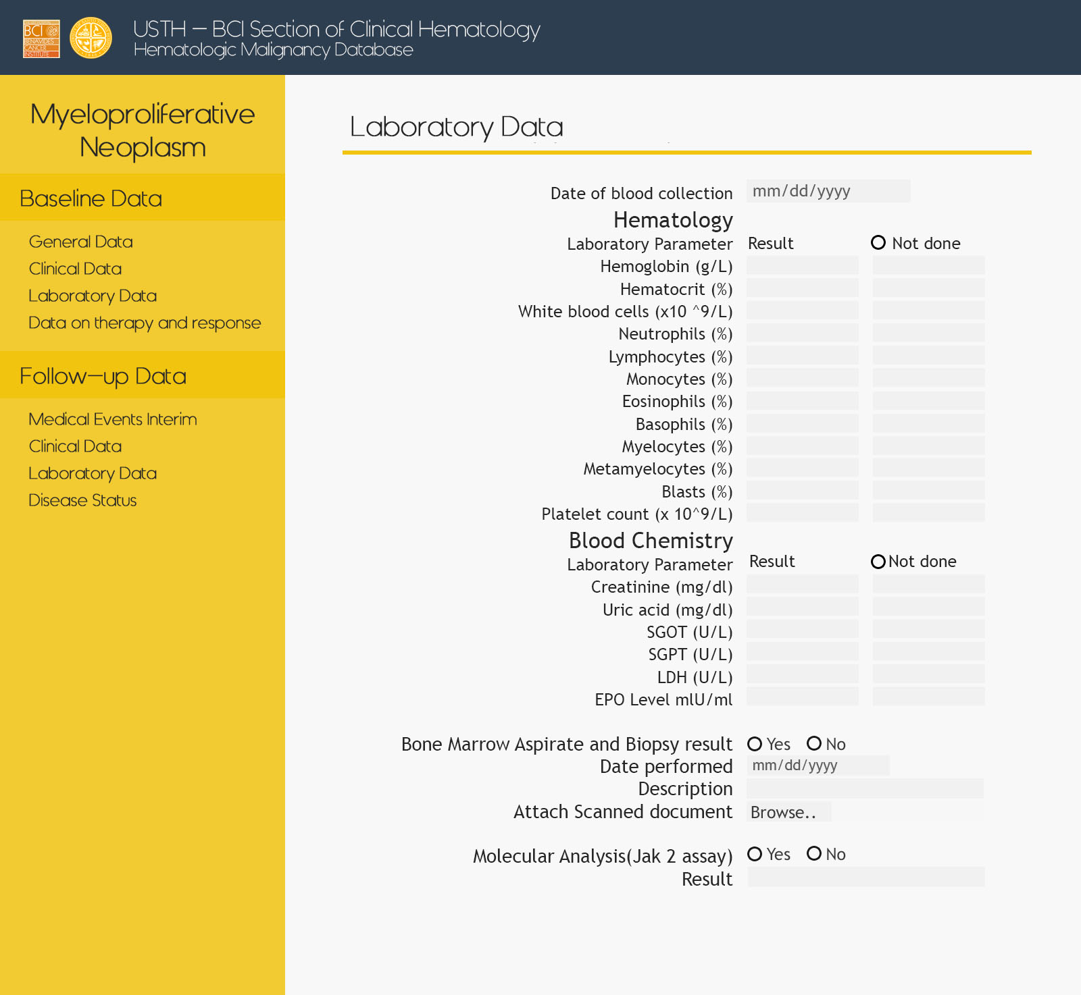
Myelo – Baseline – Laboratory

Slide 37
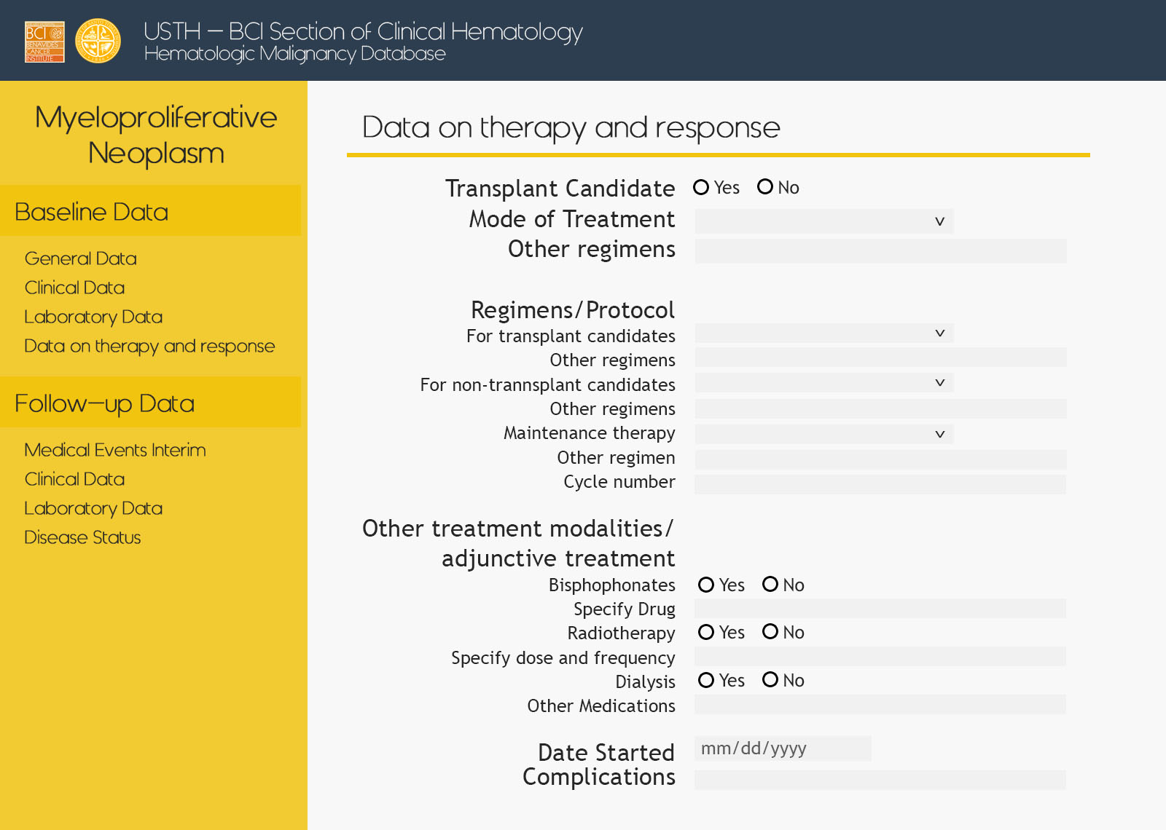
Myelo – Baseline – Therapy

Slide 38
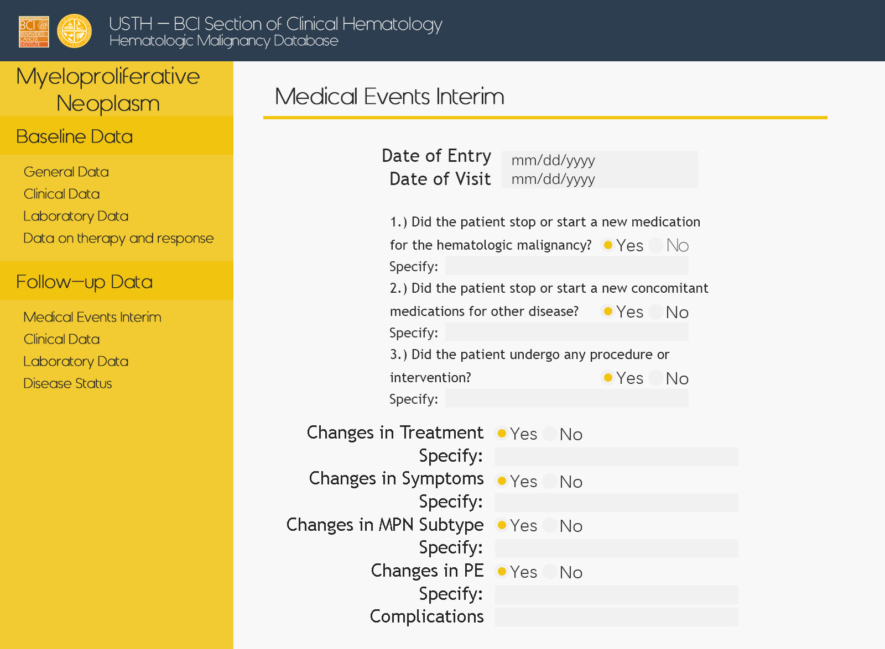
Myelo – Follow up – Med Events

Slide 39
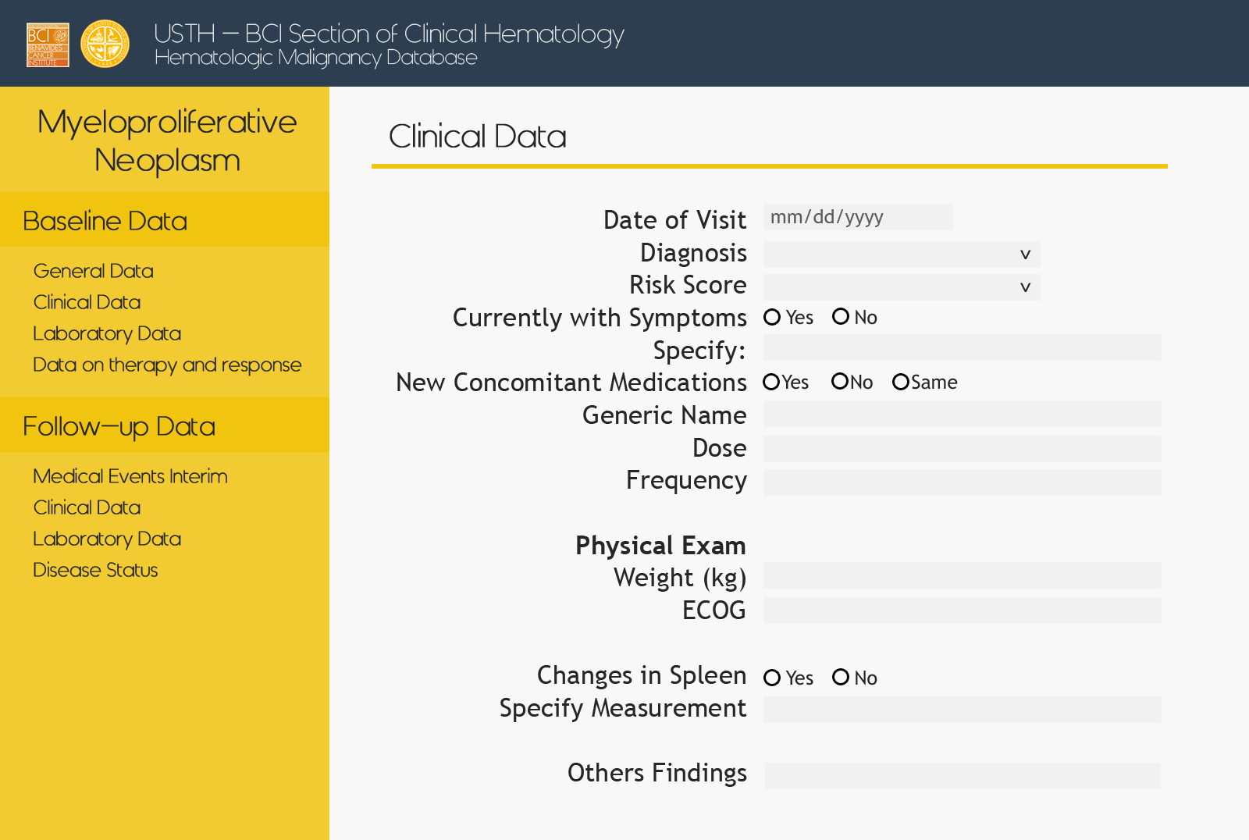
Myelo – Follow up – Clinical

Slide 40
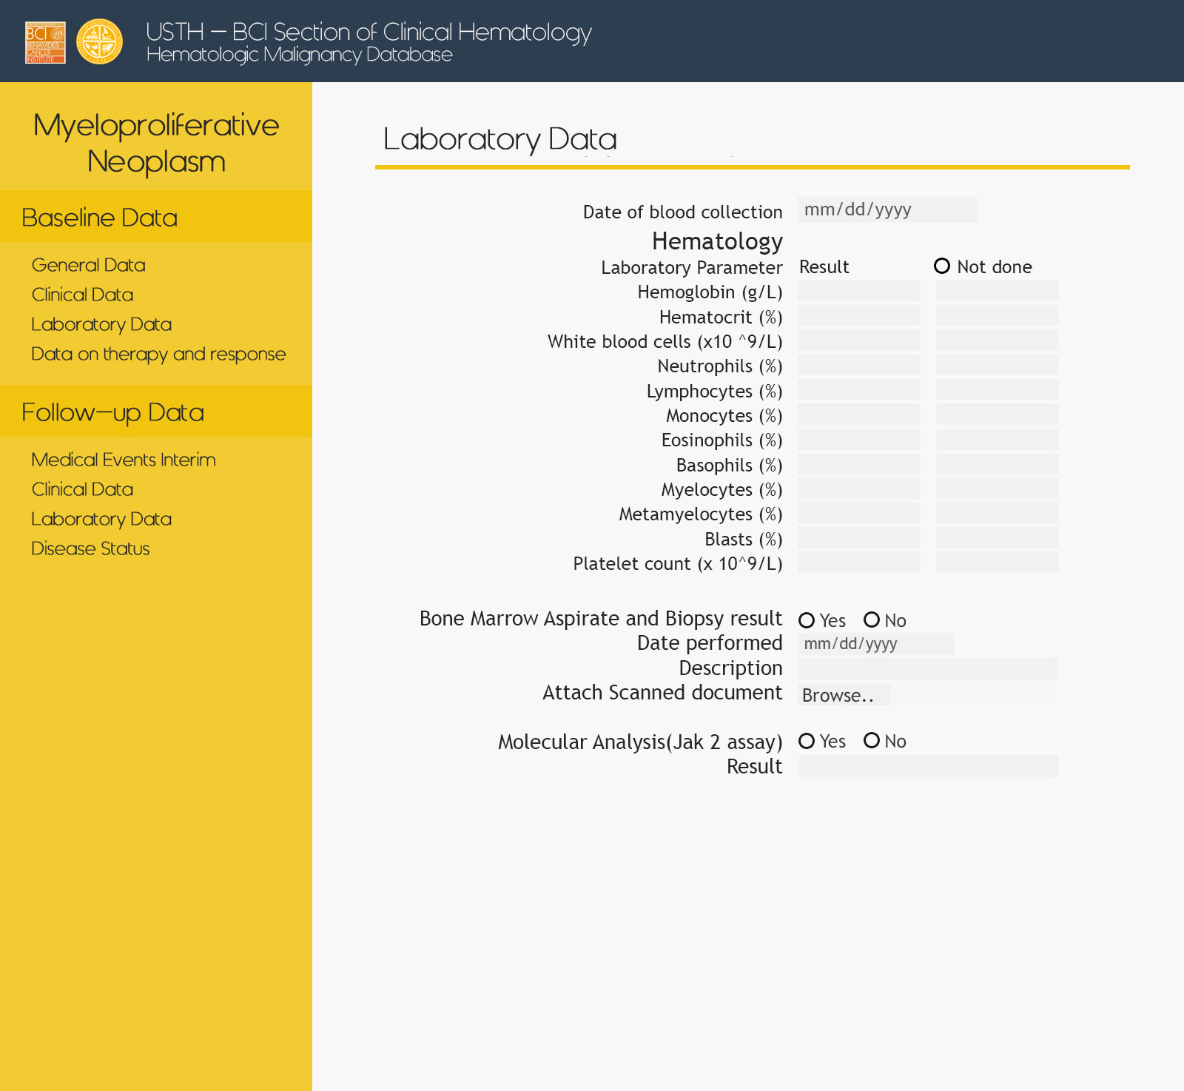
Myelo – Follow up – Laboratory

Slide 41
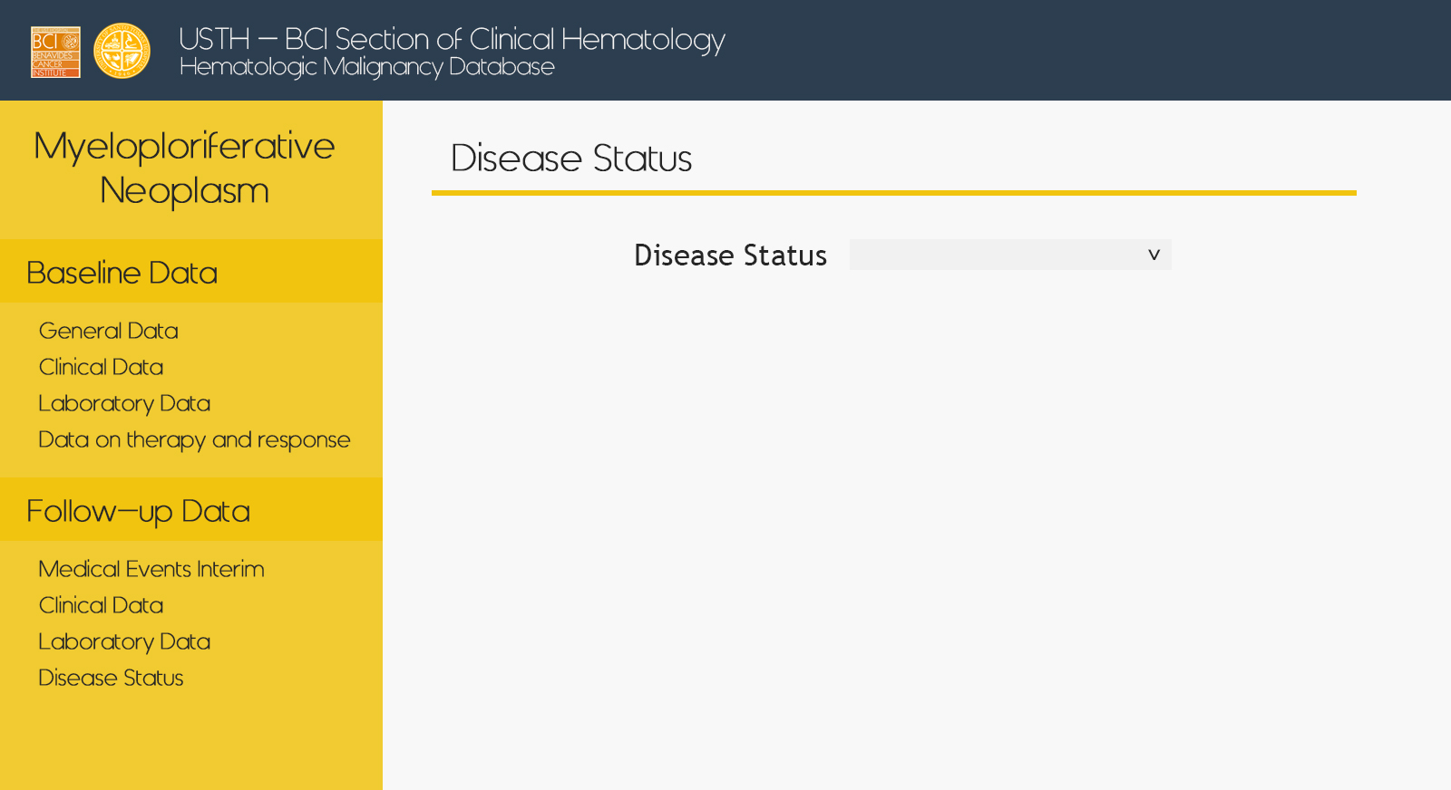
Myelo – Follow up – Disease Status

Slide 42
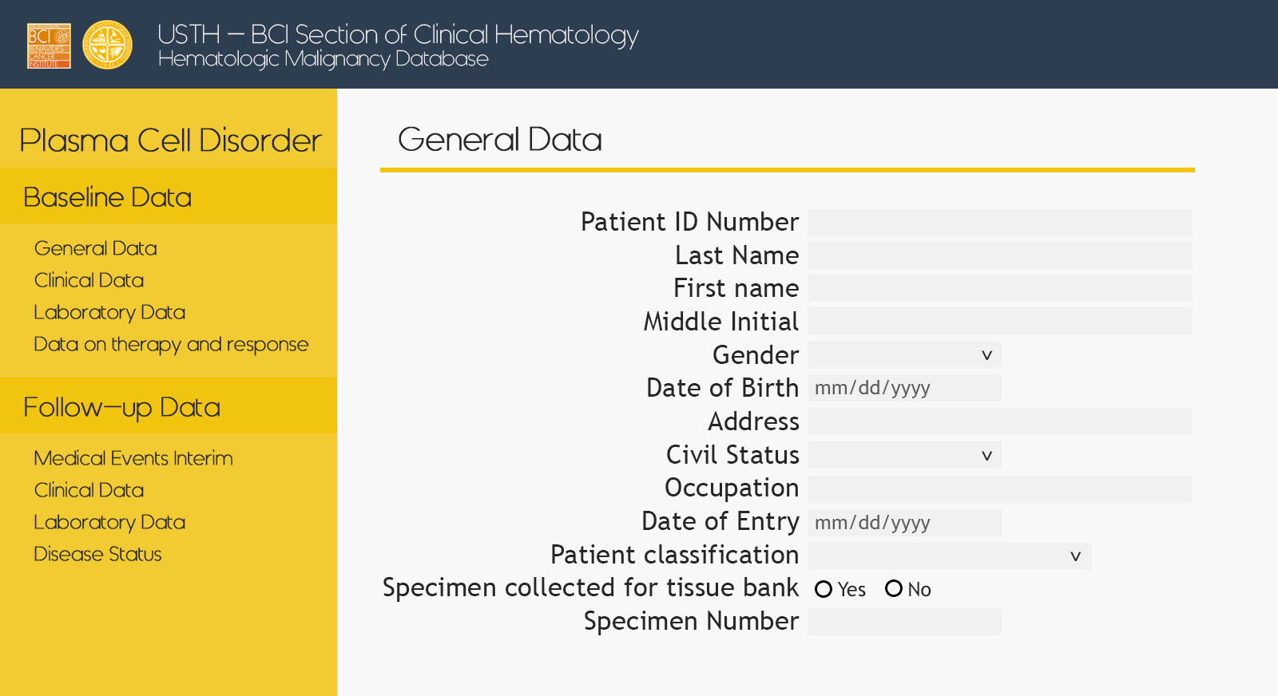
Plasma Cell – Baseline – General

Slide 43
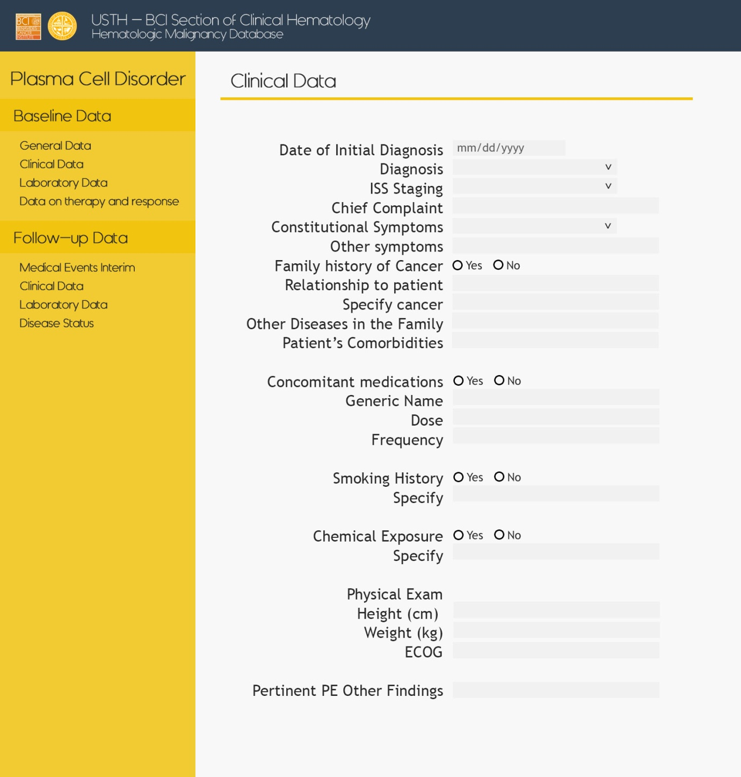
Plasma Cell – Baseline – Clinical

Slide 44
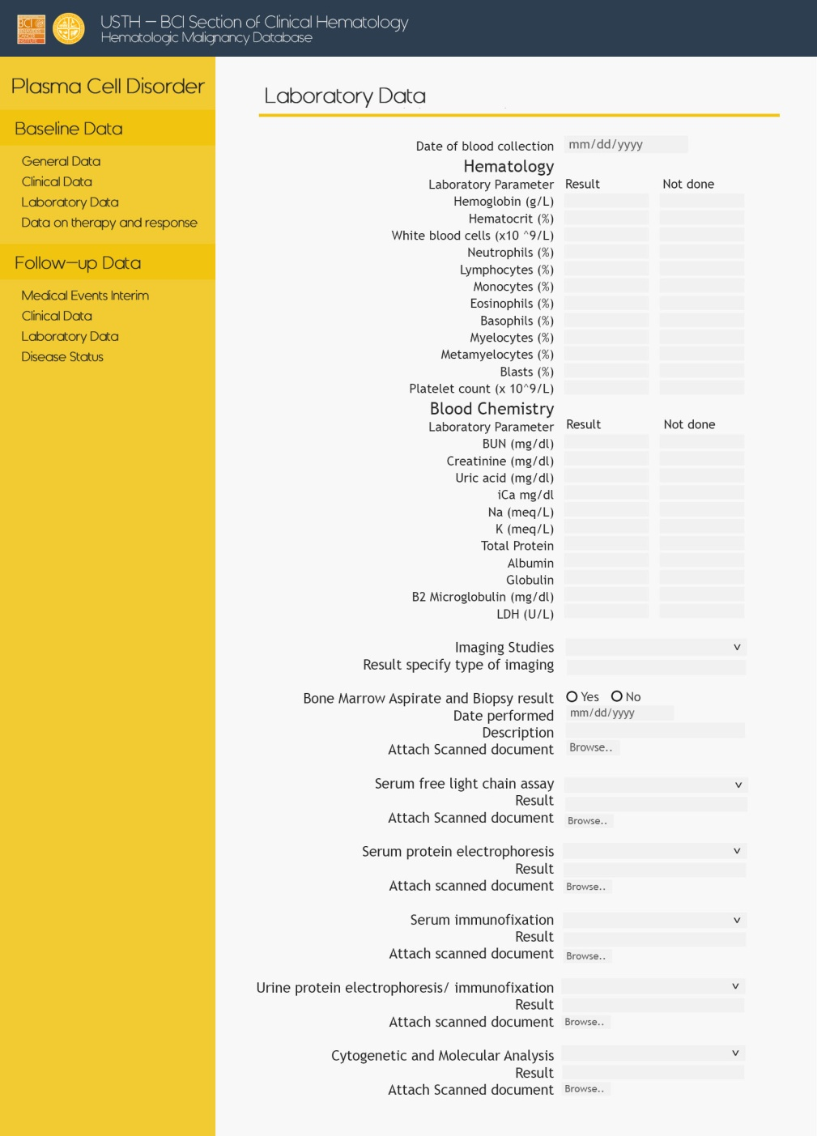
Plasma Cell – Baseline – Laboratory

Slide 45

Plasma Cell – Baseline – Therapy

Slide 46

Plasma Cell – Follow up – Med Events

Slide 47
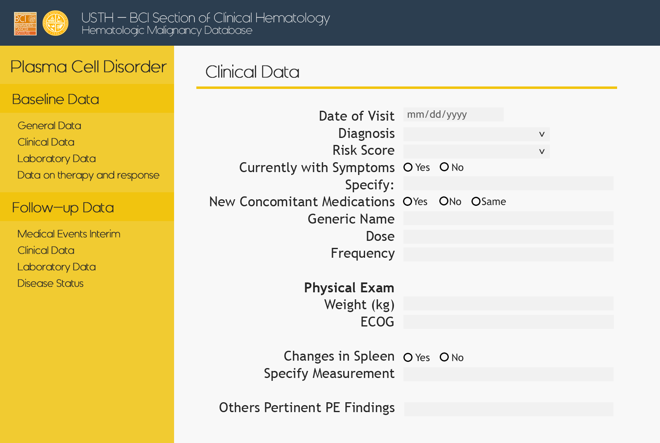
Plasma Cell – Follow up – Clinical

Slide 48

Plasma Cell – Follow up – Laboratory

Slide 49

Plasma Cell – Follow up – Disease Status

Slide 50

Platelet – Baseline – General

Slide 51
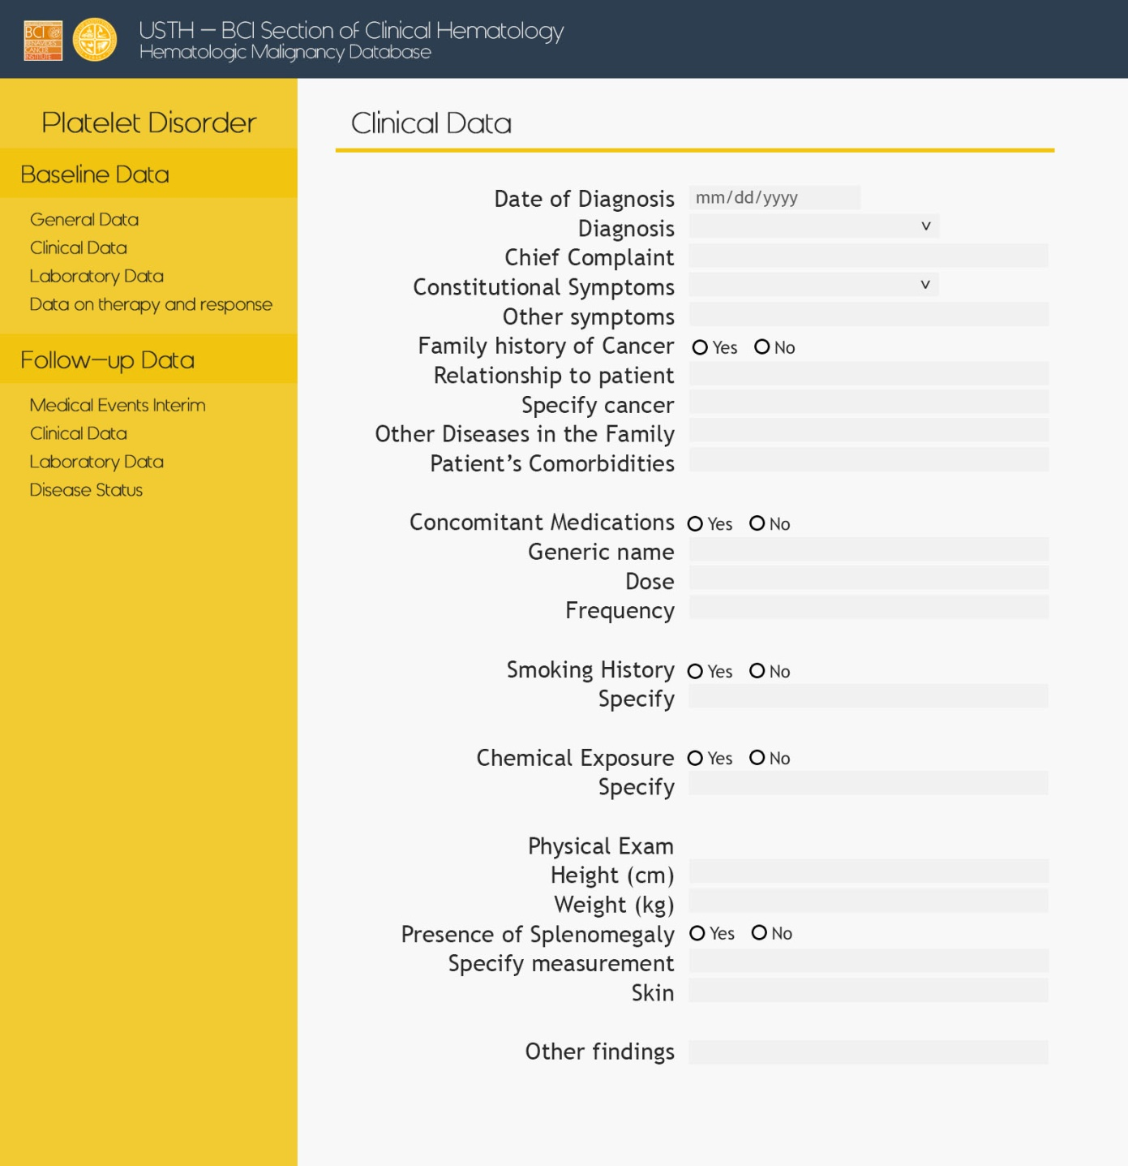
Platelet – Baseline – Clinical

Slide 52
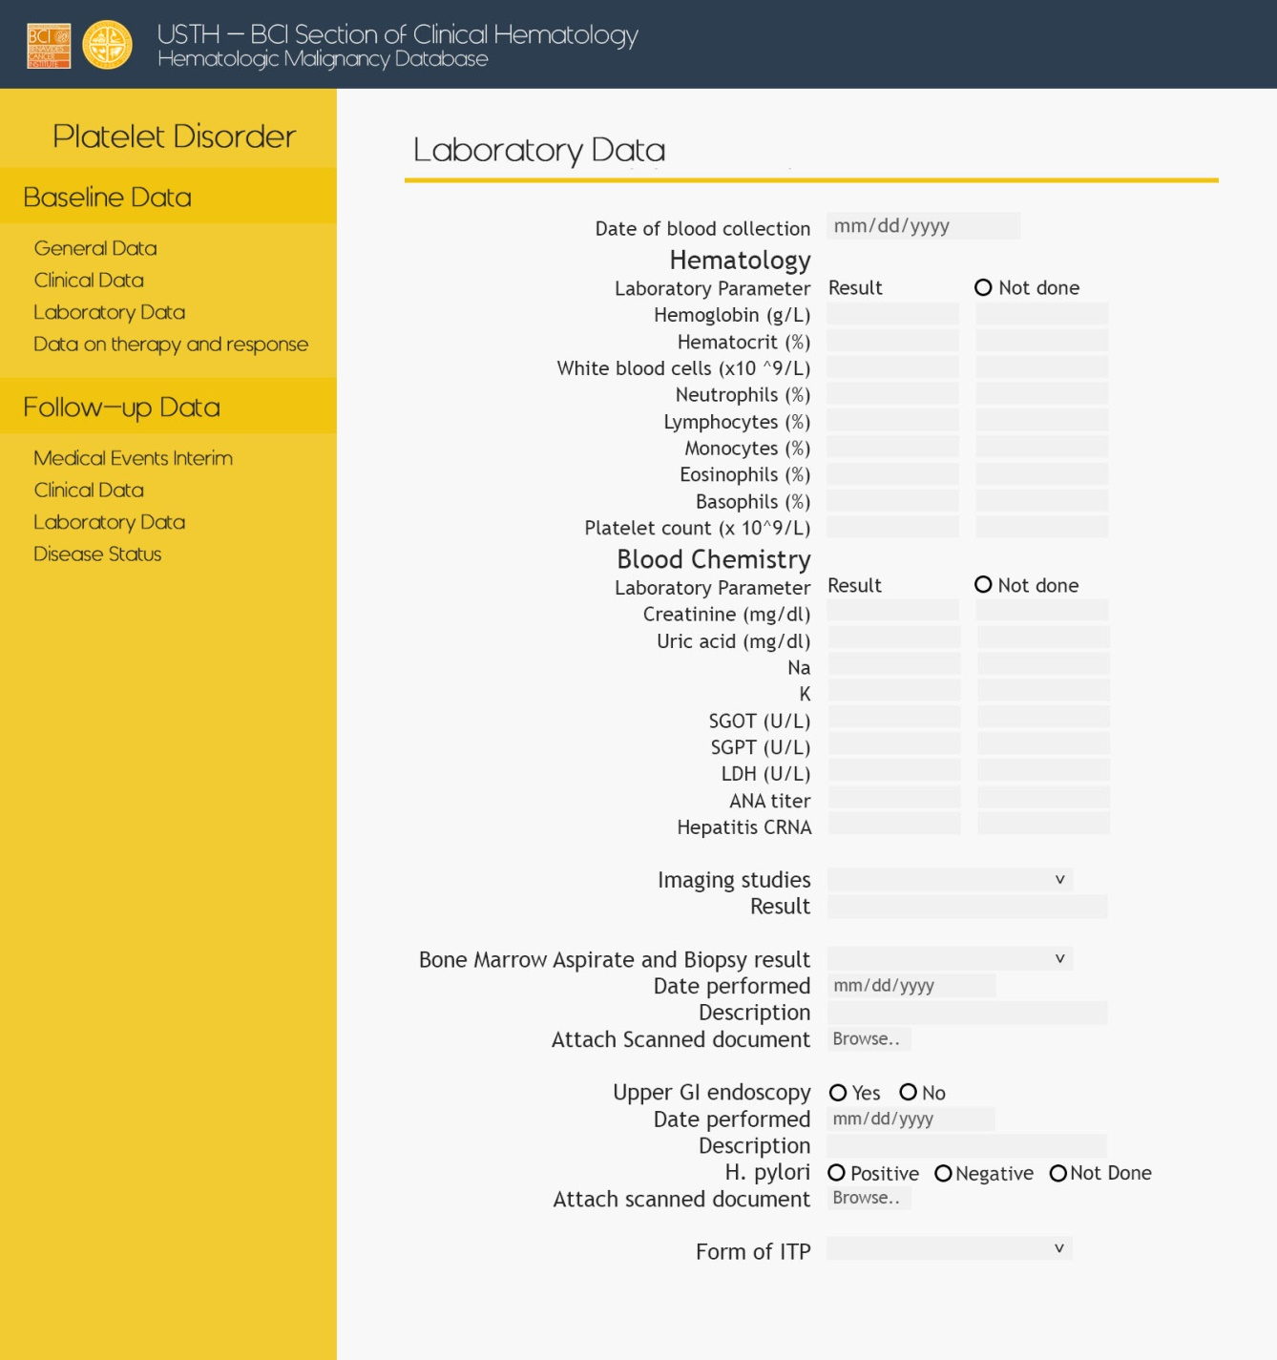
Platelet – Baseline – Laboratory

Slide 53
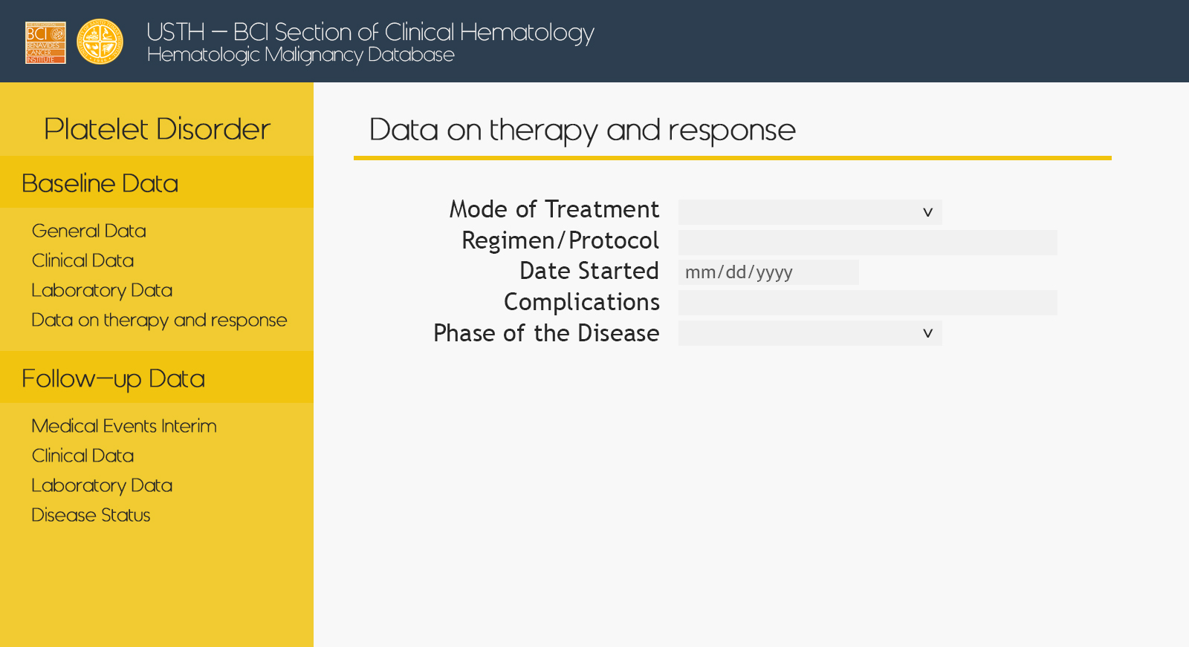
Platelet – Baseline – Therapy

Slide 54
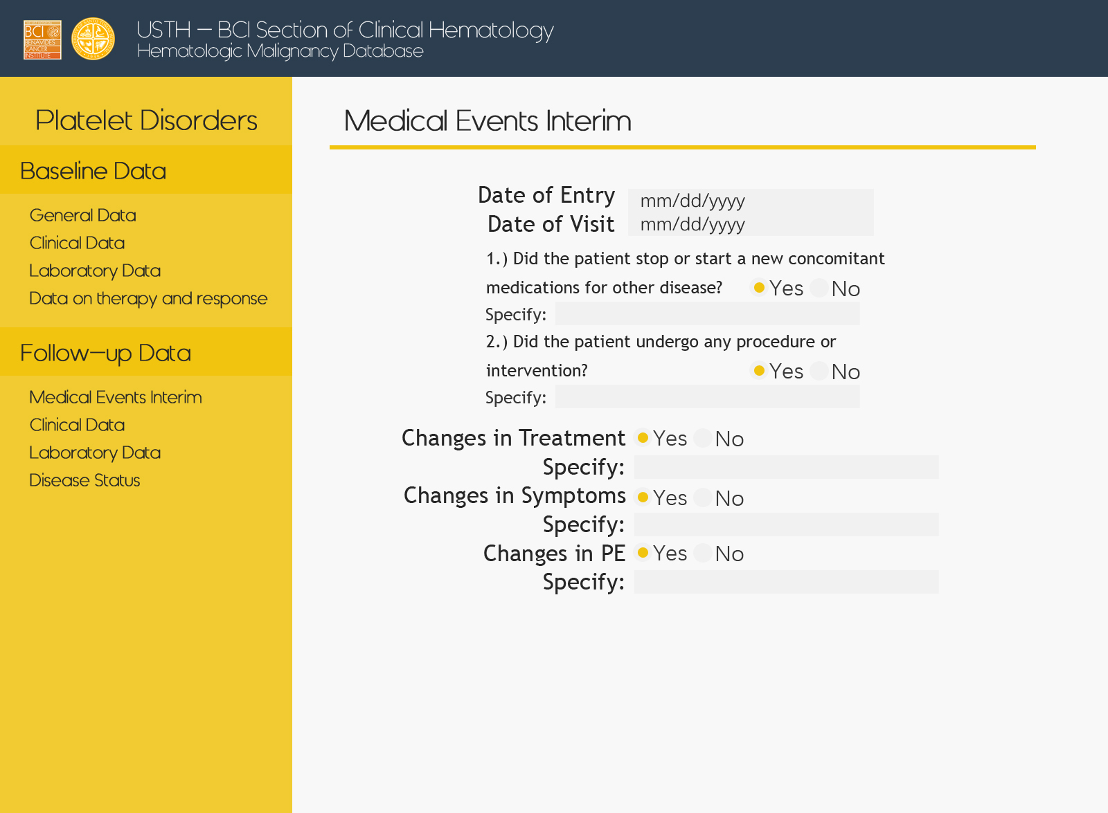
Platelet – Follow up – Med Events

Slide 55
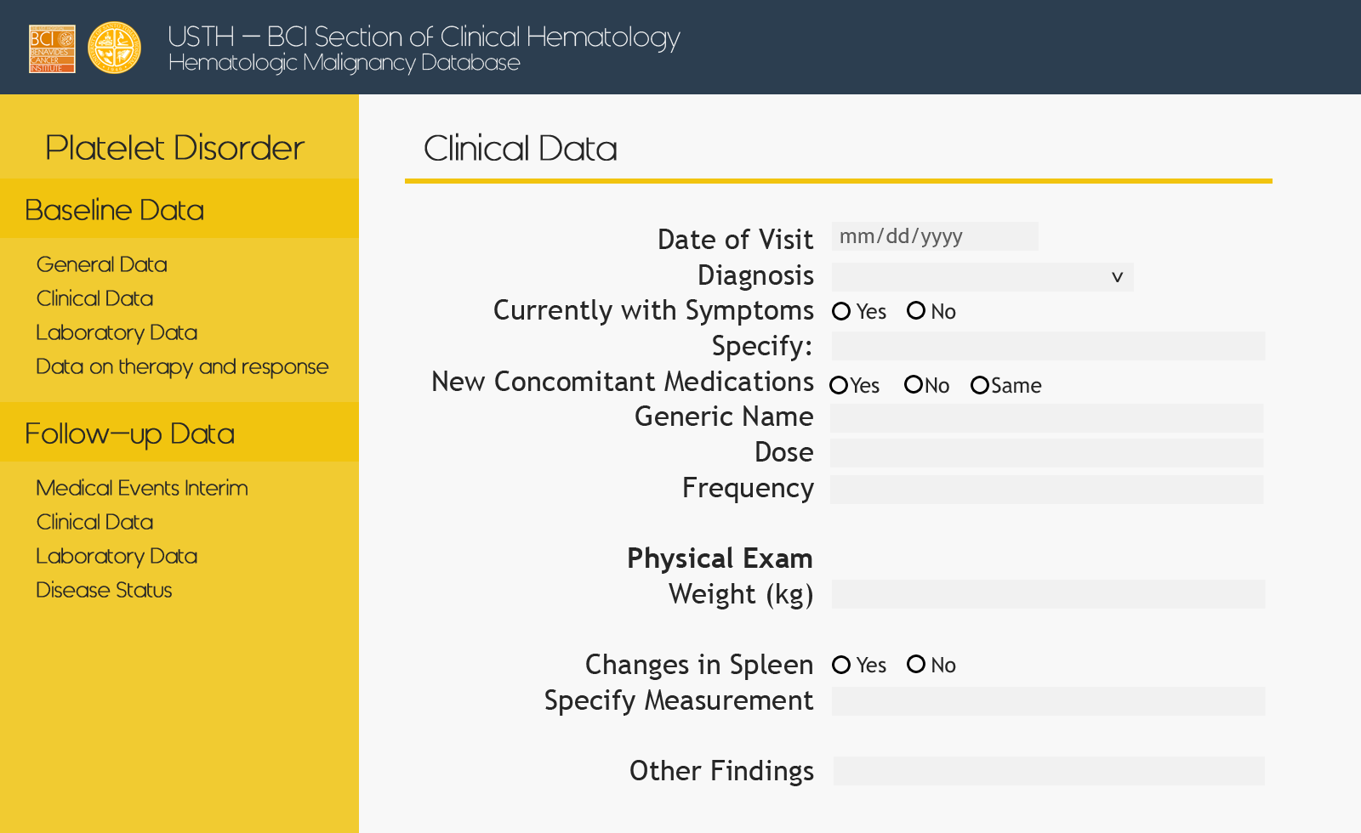
Platelet – Follow up – Clinical

Slide 56

Platelet – Follow up – Laboratory

Slide 57

Platelet – Follow up – Disease Status

